Slide 1
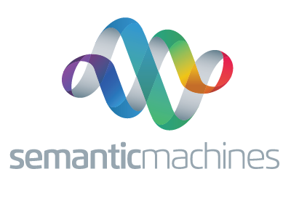
Privacy-Preserving Domain Adaptation of Semantic Parsers
Privacy-Preserving Domain Adaptation of Semantic Parser
Fatemehsadat Mireshghallah, Yu Su, Tatsunori Hashimoto, Jason Eisner, Richard Shin
Task-oriented dialogue systems often assist users with personal or confidential matters. So:
Data is private and practitioners are not allowed to look at it
How can we know where the system is failing and needs more training data or new functionality?
If some users are asking the system to hop up and down, fine-tuning is unlikely to make it grow legs.
Our goal is to produce realistic data that can be inspected (so that the developers know to build legs) and expertly annotated (to rapidly teach the semantic parser that words like “hop” and ”jump” should invoke the leg API)
(1) Problem Definition
“Could you tell me what the weather is gonna be like today in New York?”
Linguistic Coverage
Email everyone who declined the invitation.
Functional Coverage
How can we privately synthesize data that is distributionally close to eyes-off user data?
Dataset of private utterances $D_{priv}$
Private Training
DP utterance generation model $p_{θ_{x}}$ (budget 𝜖)
Synthesized utterances $D_{s}$
Data Aug-mentation
Improved semantic parser $p_{φ}$
“Could you tell me what the weather is gonna be like today in New York?”
Sample
Annotate
Annotated synthesized utterances
(2) Baseline: Vanilla DP
Privacy Barrier
Generations satisfy 𝜖
Existing annotated utterances $D_{pub}$
1-stage baseline approach of fine-tuning a pre-trained generative auto-regressive language model on private user utterances using differentially private SGD. To create the synthesized dataset we take samples from the fine-tuned model.
Dataset of private utterances $D_{priv}$
We propose a 2-stage method to exploit the inherent structure in the private user-utterance parse trees.
One stage of the process trains a parse tree generation model with DP-SGD, to model the parse trees as intermediate (latent) variables.
The other stage trains a parse2utterance model that would take the intermediate variables as input prompts and produce the utterance corresponding to them.
“Could you tell me what the weather is gonna be like today in New York?”
DP-SGD training for $T_{1}epochs$
DP parse2utterance model $p_{θyx}$
Conditional sampling
Synthesized utterances $D_{s}$
(3) Proposed: 2-stage DP
Generations satisfy $ε$
Corresponding private parse trees
Privacy Barrier
Yield
WeatherQueryApi
DateTime
Today
AtPlace
FindPlace
New York
DP-SGD
$T_{2}$ epochs
DP parse generation model $p_{θ_{y}}$
sampling
Synthesized parse trees
Comparison with Baselines
Ablation study
 |  | Language Metrics |  | Parse Metrics
 |  | W. Overlap | Mauve | Distance | F. Overlap
No DP | Baseline | 0.087 | 0.334 | 0.258 | 0.487
 | Ours | 0.236 | 0.632 | 0.085 | 0.797
$$ε=8$$ | Baseline | 0.093 | 0.198 | 0.183 | 0.487
 | Ours | 0.210 | 0.533 | 0.055 | 0.707
$$ε=3$$ | Baseline | 0.086 | 0.138 | 0.185 | 0.485
 | Ours | 0.205 | 0.530 | 0.054 | 0.693
 | Method | MAUVE | Distance
Few-modes | Baseline | 0.23 | 0.24
 | Ours | 0.21 | 0.10
Full-modes | Baseline | 0.33 | 0.25
 | Ours | 0.63 | 0.08
The effect of using few-modal data for training vs. the full dataset, on the performance of the 1-stage baseline and the proposed 2-stage method. The goal is to see if the superiority of the 2-stage method is due to it better capturing different modes in the data.
(4) Experimental Results
We can see that the proposed 2-stage method outperforms both the 1-stage baselines, at all levels of privacy budget, even when the privacy budget.
We simulated the process of discovering the need for weather-related functionality and adding it to a task-oriented dialogue system:
We train a low-resource semantic parser on 1/10th of SMCalFlow, excluding all turns that use weather-related functions.
The remaining 9/10th of the dataset act as private user utterances, including those requesting weather. We annotate them with the low-resource parser.
We apply the baseline and proposed methods to create synthesized datasets.
We annotate the synthesized datasets, using weather-related functions as for the synthetic utterances requesting weather. We re-train the parser with this additional annotated data.
Downstream Experiment: Adding Weather Functionality ($ε=3$)
 | Anonymized Graph Match | API Recall
Full Dataset | 76.6 | 77.5
Non-augmented | 0 | 2.1
Baseline | 37.7 | 42.1
Ours | 43.7 | 50.3

Slide 2
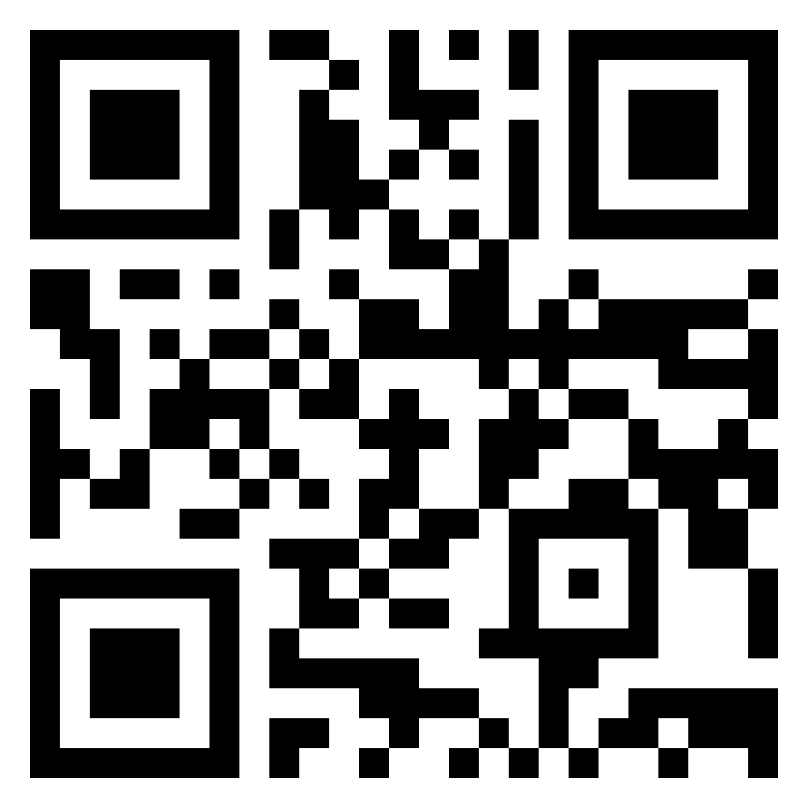
Privacy-Preserving Domain Adaptation of Semantic Parsers
Privacy-Preserving Domain Adaptation of Semantic Parser
Fatemehsadat Mireshghallah, Yu Su, Tatsunori Hashimoto, Jason Eisner, Richard Shin
Task-oriented dialogue systems often assist users with personal or confidential matters. So:
Data is private and practitioners are not allowed to look at it
How can we know where the system is failing and needs more training data or new functionality?
If some users are asking the system to hop up and down, fine-tuning is unlikely to make it grow legs.
Our goal is to produce realistic data that can be inspected (so that the developers know to build legs) and expertly annotated (to rapidly teach the semantic parser that words like “hop” and ”jump” should invoke the leg API)
(1) Problem Definition
“Could you tell me what the weather is gonna be like today in New York?”
Linguistic Coverage
Email everyone who declined the invitation.
Functional Coverage
How can we privately synthesize data that is distributionally close to eyes-off user data?
Dataset of private utterances $D_{priv}$
DP utterance generation model $p_{θ_{x}}$
Synthesized utterances $D_{s}$
Data Aug-mentation
Improved semantic parser $p_{φ}$
“Could you tell me what the weather is gonna be like today in New York?”
DP-SGD training
Sample
Annotate
Annotated synthesized utterances
(2) Baseline: Vanilla DP
Privacy Barrier
Generations satisfy 𝜖
Existing annotated utterances $D_{pub}$
We model $p(x)$, where $x$ is a private utterance: 1-stage baseline approach of fine-tuning a pre-trained generative auto-regressive language model on private user utterances using differentially private SGD. To create the synthesized dataset we take samples from the fine-tuned model.
Dataset of private utterances $D_{priv}$
“Could you tell me what the weather is gonna be like today in New York?”
DP-SGD training
DP parse2utterance model $p_{θyx}$
Intuitive Baseline: We model $p(x)$, where $x$ is a private utterance.
Proposed: We model $p\left(y\right)$ and $p(x|y)$, where $y$ is a private parse-tree.
one stage models the parse-trees, $p_{θ_{y}}$
The other stage models an utterance given a parse-tree, $p_{θyx}$
(3) Proposed: 2-stage DP
Privacy Barrier
Corresponding private parse trees
Yield
WeatherQueryApi
DateTime
Today
AtPlace
New York
DP-SGD
DP parse generation model $p_{θ_{y}}$
Comparison with Baselines
Ablation study
 |  | Language Metrics |  | Parse Metrics
 |  | W. Overlap | Mauve | Distance | F. Overlap
No DP | Baseline | 0.087 | 0.334 | 0.258 | 0.487
 | Ours | 0.236 | 0.632 | 0.085 | 0.797
$$ε=8$$ | Baseline | 0.093 | 0.198 | 0.183 | 0.487
 | Ours | 0.210 | 0.533 | 0.055 | 0.707
$$ε=3$$ | Baseline | 0.086 | 0.138 | 0.185 | 0.485
 | Ours | 0.205 | 0.530 | 0.054 | 0.693
 | Method | MAUVE | Distance
Few-modes | Baseline | 0.23 | 0.24
 | Ours | 0.21 | 0.10
Full-modes | Baseline | 0.33 | 0.25
 | Ours | 0.63 | 0.08
The effect of using data with few modes for training vs. the full dataset, on the performance of the 1-stage baseline and the proposed 2-stage method. The goal is to see if the superiority of the 2-stage method is due to it better capturing different modes in the data.
(4) Experimental Results
We can see that the proposed 2-stage method outperforms the 1-stage baselines, at all levels of privacy budget.
We simulated a situation where users are asking about the weather but the original semantic parser was not trained on weather-related functions:
We created the original semantic parser by training on $\frac{1}{10}$ of our data (SMCalFlow), excluding any examples that use weather-related functions.
We treated the other $\frac{9}{10}$ of the data as private user utterances, including those requesting weather. We created approximate private annotations for the private utterances, using the original semantic parser.
We apply the baseline and proposed methods to create public synthesized datasets, which include weather functions.
We simulated high-quality human annotation of the public synthetic utterances. We re-train the parser with this additional annotated data.
Downstream Experiment: Adding Weather Functionality ($ε=3$)
 | Anonymized Graph Match | API Recall
Full Dataset | 76.6 | 77.5
Non-augmented | 0 | 2.1
Baseline | 37.7 | 42.1
Ours | 43.7 | 50.3

