Slide 1



Bayesian Modeling of Lexical Resources for Low-Resource Settings
Nicholas Andrews
with Mark Dredze, Benjamin Van Durme, and Jason Eisner

Slide 2
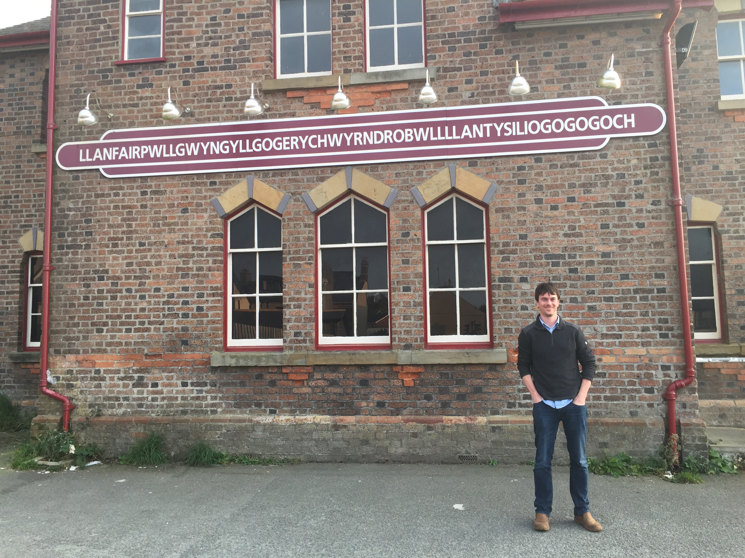
A place name
Notes:
Here's the name of a place in Wales.
What if rather than seeing a picture, you just saw it in text?
Would you know its a place name?

Slide 3

This Talk: Sequence Labeling
Corpus
... known as [Llanfairpwllgwyngyll] …
y_{t} = Person? Location? Other?
Notes:
If you just saw that name in text, how do you know what it is?

Slide 4

This Talk: Sequence Labeling with Gazetteers
Gazetteer
Llanfairpwllgwyngyll
Jacksonville
New York
Allentown
Corpus
... known as [Llanfairpwllgwyngyll] …
y_{t} = Person? Location? Other?
Notes:
Specifically, it's a talk about sequence labeling with gazetteers: lists of known place names
(Or other external knowledge)

Slide 5
This Talk in One Slide
Gazetteer
Llanfairpwllgwyngyll
Jacksonville
…
P_{θ}(y | , x)
Don’t Condition
on the gazetteer:
Do Generate the gazetteer!
Gazetteer
Llanfairpwllgwyngyll
Jacksonville
…
P_{θ}( , x, y)
Notes:
Regardless of HOW you parametrize your model, CONDITIONING on a GAZETTEER is BAD. You should **GENERATE** the gazetteer.

Slide 6
Warning: Pick a good generative model
It’s easy to have rich discriminative models
A little harder for generative models, but possible:
  High-resource case: LSTM language models
  Low-resource case (this paper): hierarchical Bayesian LMs

Slide 7
PART I: GAZETTEER FEATURES
Notes:
To motivate the proposed approach, I want to start by explaining lexical resources like gazetteers are typically incorporated into sequence models.

Slide 8
Discriminative Named-Entity Recognition
Corpus
he went to [Jacksonville]
Person? Location?
What type is Jacksonville?
Notes:
Let’s review basic named-entity recognition.

Slide 9
Discriminative Named-Entity Recognition
Corpus
he went to [Jacksonville]
Person? Location?
What type is Jacksonville?
Notes:
Parameters that score the effect of different parts of the input, corresponding to human-designed features or neural networks

Slide 10
Discriminative Named-Entity Recognition
Corpus
he went to [Jacksonville]
Person? Location?
Location!
θ_{context}
P_{θ}(labels | words)
Notes:
Parameters that score the effect of different parts of the input, corresponding to human-designed features or neural networks

Slide 11
Discriminative Named-Entity Recognition
Corpus
he went to [Jacksonville]
Person? Location?
Location!
Location!
θ_{context}
θ_{spelling}
P_{θ}(labels | words)
Notes:
We might also have parameters associated with spelling, which in this case could pick up on the –ville SUFFIX

Slide 12
Discriminative Named-Entity Recognition
Corpus
he went to [Jacksonville]
y_{t} = loc
Location!
Location!
θ_{context}
θ_{spelling}
P_{θ}(labels | words)
Notes:
Put together, we can then predict that Jacksonville is a location. We proceed for all other tokens in the sentence.

Slide 13
What if context and spelling aren’t enough?
Corpus
... known as [Llanfairpwllgwyngyll] …
y_{t} = Person? Location?
Notes:
Uncertain context, unlikely spelling

Slide 14
What if context and spelling aren’t enough?
Corpus
... known as [Llanfairpwllgwyngyll] …
y_{t} = Person? Location?
?
θ_{context}
Notes:
“Barack Obama is known as BLANK” or “The town of X is known as Y”

Slide 15
What if context and spelling aren’t enough?
Corpus
... known as [Llanfairpwllgwyngyll] …
y_{t} = Person? Location?
?
?
θ_{context}
θ_{spelling}

Slide 16
Hmm, what if we had some sort of list of names we knew were locations?
Corpus
... known as [Llanfairpwllgwyngyll] …
y_{t} = ?
?
?
θ_{context}
θ_{spelling}

Slide 17

Solution: use Gazetteers
Gazetteer
Llanfairpwllgwyngyll
Jacksonville
New York
Allentown
البرت اينشتاين
এলবাৰ্ট আইনষ্টাইন
Albert Einstein
Albert Eynşteyn
Alberts Einšteins
Альберт Эйнштейн
Notes:
Gazetteers are lists of distinct places, but in general we mean lists of names, dictionaries, etc. This is ***type-level*** supervision.

Slide 18
Gazetteer Features
Gazetteer
Llanfairpwllgwyngyll
Jacksonville
New York
Allentown
Corpus
... known as [Llanfairpwllgwyngyll] …
1 IF str IN GAZ
0 OTHERWISE
GazFeature(str) :=
Notes:
The usual way of incorporating gazetteer feature

Slide 19
Gazetteer
Llanfairpwllgwyngyll
Jacksonville
New York
Allentown
Corpus
... known as [Llanfairpwllgwyngyll] …
y_{t} = loc
?
Location!
?
θ_{context}
θ_{gazetteer}
θ_{spelling}

Slide 20
PART II: THE TROUBLE WITH GAZETTEER FEATURES
Notes:
Now I want to talk about the limitations of this approach

Slide 21
What goes wrong with gazetteer features
Overfitting: gazetteer inhibits learning of spelling + context features from annotated corpus
Discriminative training doesn’t learn spelling information from the gazetteer
Notes:
Summarize problems, then explain each one

Slide 22
The larger the gazetteer, the more we overfit
Corpus
[...] a statement from Clinton […]
Gazetteer
Llanfairpwllgwyngyll
Training Corpus
… known as [Llanfairpwllgwyngyll] …
… he went to [Jacksonville] …
She is from [New York]
… a statement from [Allentown] …
θ_{context}
θ_{gazetteer}
θ_{spelling}
Notes:
Coverage of train types is increasing as we add items to the gazetteer. This can result in overfitting

Slide 23
The larger the gazetteer, the more we overfit
Corpus
[...] a statement from Clinton […]
Gazetteer
Llanfairpwllgwyngyll
*Jacksonville*
Training Corpus
… known as [Llanfairpwllgwyngyll] …
… he went to [*Jacksonville*] …
She is from [New York]
… a statement from [Allentown] …
θ_{context}
θ_{gazetteer}
θ_{spelling}

Slide 24
The larger the gazetteer, the more we overfit
Corpus
[...] a statement from Clinton […]
Gazetteer
Llanfairpwllgwyngyll
Jacksonville
*New York*
Training Corpus
… known as [Llanfairpwllgwyngyll] …
… he went to [Jacksonville] …
She is from [*New York*]
… a statement from [Allentown] …
θ_{context}
θ_{gazetteer}
θ_{spelling}

Slide 25
The larger the gazetteer, the more we overfit
Corpus
[...] a statement from Clinton […]
Gazetteer
Llanfairpwllgwyngyll
Jacksonville
New York
*Allentown*
Training Corpus
… known as [Llanfairpwllgwyngyll] …
… he went to [Jacksonville] …
She is from [New York]
… a statement from [*Allentown*] …
θ_{context}
θ_{gazetteer}
θ_{spelling}

Slide 26
The larger the gazetteer, the more we overfit
Corpus
[...] a statement from Clinton […]
Gazetteer
Llanfairpwllgwyngyll
Jacksonville
New York
Allentown
Train TEST Corpus
A statement by [Townville] …
θ_{context}
θ_{gazetteer}
θ_{spelling}
Notes:
At test time, the gazetteer features have large weight but nothing useful to say. Meanwhile, the generalizable features (context and spelling) are underweight.

Slide 27
The larger the gazetteer, the more we overfit
Corpus
[...] a statement from Clinton […]
Gazetteer
Llanfairpwllgwyngyll
Jacksonville
New York
Allentown
Train TEST Corpus
A statement by [Townville] …
“Townville” not in gazetteer.
Person!
Location!
θ_{context}
θ_{gazetteer}
θ_{spelling}
Notes:
At test time, the gazetteer features have large weight but nothing useful to say. Meanwhile, the generalizable features (context and spelling) are underweight.

Slide 28
What goes wrong with gazetteer features
Overfitting: gazetteer inhibits learning of spelling + context features from annotated corpus
Discriminative training doesn’t learn spelling information from the gazetteer
Aren’t more observations supposed to help?
The Problem: so far, we use gazetteer as features not observations
Notes:
Summarize problems, then explain each one

Slide 29
Gazetteer Features Ignore Information
Test Corpus
A statement by [Townville] …
Gazetteer
Llanfairpwllgwyngyll
Jacksonville
New York
Allentown
Corpus
[...] a statement from Clinton […]
Can we learn spelling from the gazetteer?
29
Notes:
What we’d like is to learn spelling from the gazetteer **directly**, so that we can generalize to “TownVille” above even though it doesn’t appear in the gazetteer.

Slide 30
Prior Work
We are not the first to notice some of these issues
  “Weight undertraining” (Sutton et al., 2006)
CRF-specific remedies have been proposed
  Logarithmic opinion pools (Smith et al., 2005)
Our Solution:
Model the corpus and the gazetteer jointly

Slide 31
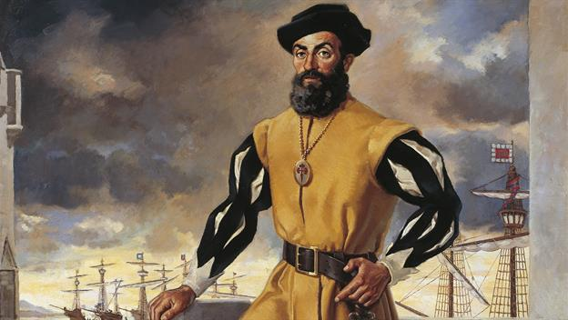
PART III:
GENERATE THE GAZETTEER
Notes:
We stipulate an underlying generative process for both the gazetteer types and tokens in context.

Slide 32
Explorer’s Gazetteer
Jacksonville
Allentown
Greenville
Georgetown
Explorer’s Diary
… known as Centertown …
… he went to Townville …
She is from Georgeville
… a statement from Allentown
Notes:
We stipulate some naming process generated the places in **BOTH** the gazetteer and the training data. As a result, we don’t need to think of lexical resources as some special thing: they’re just data. Think of this as a kind of multi-task training.

Slide 33
Explorer names new places
Explorer’s Gazetteer
Jacksonville
Allentown
Greenville
Georgetown
Notes:
We stipulate some naming process generated the places in **BOTH** the gazetteer and the training data. As a result, we don’t need to think of lexical resources as some special thing: they’re just data. Think of this as a kind of multi-task training.

Slide 34
Explorer names new places
P_{spelling}(name | y_{t} = loc)
Explorer’s Gazetteer
Jacksonville
Allentown
Greenville
Georgetown
Notes:
The explorer is representing a spelling model, which represents common spellings of places

Slide 35
Explorer writes about places
Explorer’s Gazetteer
Jacksonville
Allentown
Greenville
Georgetown
Explorer’s Diary
… known as Centertown …
… he went to Townville …
She is from Georgeville
… a statement from Allentown
Notes:
We stipulate some naming process generated the places in **BOTH** the gazetteer and the training data. As a result, we don’t need to think of lexical resources as some special thing: they’re just data. Think of this as a kind of multi-task training.

Slide 36
NOTE: the SAME spelling model generates both types and tokens
P_{context}(y_{t} = loc | context) * P_{spelling}(name | y_{t} = loc)
Explorer’s Gazetteer
Jacksonville
Allentown
Greenville
Georgetown
Explorer’s Diary
… known as Centertown …
… he went to Townville …
She is from Georgeville
… a statement from Allentown
Notes:
We stipulate some naming process generated the places in **BOTH** the gazetteer and the training data. As a result, we don’t need to think of lexical resources as some special thing: they’re just data. Think of this as a kind of multi-task training.

Slide 37
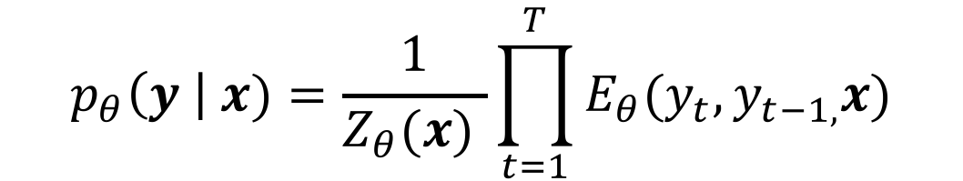
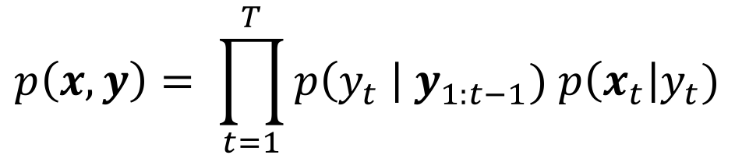
(Conditional model)
(Proposed model)
$$p_{θ}\left(y \right| x)=\frac{1}{Z_{θ}(x) }\prod_{t=1}^{T}{E_{θ}(y_{t}, y_{t−1,}x)}$$
$$p\left(x, y\right)= \prod_{t=1}^{T}{p\left(y_{t} \right| y_{1:t−1}) p\left(x_{t}\right|y_{t})}$$
Condition on x
Model x: gazetteer + corpus
Notes:
On the left we have a usual discriminative model, where we condition

Slide 38
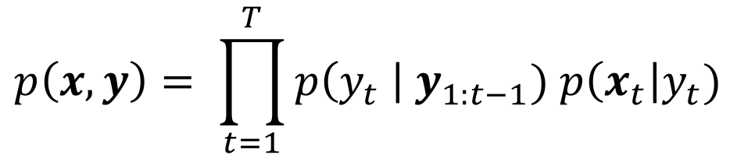
y_{t-2}
y_{t-1}
y_{t}
$$p\left(x, y\right)= \prod_{t=1}^{T}{p\left(y_{t} \right| y_{1:t−1}) p\left(x_{t}\right|y_{t})}$$
Context model
Notes:
Context model: what label is likely in what context

Slide 39
y_{t-2}
y_{t-1}
y_{t}
x_{t}
$$p\left(x, y\right)= \prod_{t=1}^{T}{p\left(y_{t} \right| y_{1:t−1}) p\left(x_{t}\right|y_{t})}$$
Spelling Model
Notes:
Context model: what label is likely in what context

Slide 40
We can now generalize from the gazetteer!
Gazetteer
Llanfairpwllgwyngyll
Jacksonville
New York
Allentown
Test Corpus
A statement by [Townville] …
Location!
P_{spelling}(T, o, w, n, v, i, l, l, e | y_{t} = location)
Notes:
The joint model can learn generalizable features from the gazetteer, without requiring exact match.

Slide 41
We can now generalize from the gazetteer!
Gazetteer
Llanfairpwllgwyngyll
Jacksonville
New York
Allentown
Test Corpus
A statement by [Townville] …
Location!
“Townville” not in gazetteer.
VERSUS
P_{spelling}(T, o, w, n, v, i, l, l, e | y_{t} = location)
θ_{gazetteer}
Notes:
The joint model can learn generalizable features from the gazetteer, without requiring exact match.

Slide 42
What about Llanfair­pwllgwyngyll­gogery­chwyrn­drobwll
Problem: P_{spelling}(L, l, a, n, f, a, i, r, p, w, l, l, … | y = loc) is tiny
Notes:
We’ve solved one problem with our model, learning spelling from the gazetteer. But it seems like we’ve lost something from gazetteer features?

Slide 43
What about Llanfair­pwllgwyngyll­gogery­chwyrn­drobwll
Problem: P_{spelling}(L, l, a, n, f, a, i, r, p, w, l, l, … | y = loc) is tiny
But gazetteer features handled this case!
Gazetteer features recognize specific strings via:
Even a weirdly spelled name is a location, if it’s in gazetteer!
1 IF str IN GAZ
0 OTHERWISE
GazFeature(str) :=
Notes:
We’ve solved one problem with our model, learning spelling from the gazetteer. But it seems like we’ve lost something from gazetteer features?

Slide 44
What about Llanfair­pwllgwyngyll­gogery­chwyrn­drobwll
Problem: P_{spelling}(L, l, a, n, f, a, i, r, p, w, l, l, … | y = loc) is tiny
Even a weirdly spelled name is still a name, if it’s in gazetteer!
Can we account for this in generative model?
1 IF str IN GAZ
0 OTHERWISE
GazFeature(str) :=
Notes:
We’ve solved one problem with our model, learning spelling from the gazetteer. But it seems like we’ve lost something from gazetteer features?

Slide 45
Solution: Stochastic Memoization
With probability α:
Sample an existing word in the gazetteer
E.g. “Llanfairpwllgwyngyll”
Gazetteer
Llanfairpwllgwyngyll
Jacksonville
New York
Allentown
Notes:
But gazetteer features are NOT just learning spelling. They also give a boost for words appearing exactly in the gazetteer.

Slide 46
Solution: Stochastic Memoization
With probability α:
Sample an existing word in the gazetteer
E.g. “Llanfairpwllgwyngyll”
With probability 1 – α:
Spell a new word character-by-character
E.g. “Townville”
Gazetteer
Llanfairpwllgwyngyll
Jacksonville
New York
Allentown
Notes:
But gazetteer features are NOT just learning spelling. They also give a boost for words appearing exactly in the gazetteer.

Slide 47
Solution: Stochastic Memoization
With probability α:
Sample an existing word in the gazetteer
E.g. “Llanfairpwllgwyngyll”
With probability 1 – α:
Spell a new word character-by-character
E.g. “Townville”
Gazetteer
Llanfairpwllgwyngyll
Jacksonville
New York
Allentown
α P_{cache}(word) + (1 – α) P_{spelling}(x = w, o, r, d | y = label)
Notes:
Say: the result is that even places with weird names will be likely if they appear in the gazetteer.

Slide 48
Summary & Trade-offs
Condition on the Gazetteer
Fewer independence assumptions
Gazetteer features: may overfit
Does not model the gazetteer; needs annotated data to learn spelling
Generate the Gazetteer
More independence assumptions
Gazetteer is data: no overfitting
Learns spelling from gazetteers; no need for supervised data

Slide 49
PART IV: EXPERIMENTS
LOW-RESOURCE NAMED-ENTITY RECOGNITION +
PART-OF-SPEECH INDUCTION

Slide 50
Experiment 1: Low-Resource NER
Language: Turkish
Baseline: CRF with gazetteer features
We vary:
Supervision: 1 to 500 sentences
Gazetteers size: 10, 100, 1000
  For each type: person, location, organization, other

Slide 51
F1 of model
minus
F1 of baseline
NUMBER OF LABELED SENTENCES FOR TRAINING
Notes:
Please note here that:
the y-axis is the relative outperformance of our proposed model
Values larger than 0 indicate that our model is outperforming the baseline by that amount
The different series correspond to different size gazetteers
The error bars are over 10 replications

Slide 52
Experiment 2: Part-of-Speech Induction
Use Wiktionary entries as a “gazetteer”
  (Incomplete) dictionary: words and their parts-of-speech
Baseline: HMM trained with EM (Li et al., 2012)
  dictionary as constraints on possible parts-of-speech for each word type
Data: CoNLL-X and CoNLL 2007 languages
Notes:
We can also use our model for unsupervised problems. Here we present results for part-of-speech induction with a dictionary.

Slide 53
Notes:
We show consistent improvements over the baseline model (results with more languages in the paper)
Disclaimer: our model is more expressive than the baseline here, so we’re not isolating the effect of gazetteer as contraint vs. generate the gazetteer

Slide 54
Concluding Remarks

Slide 55
Key ideas / take-aways
Discriminative training has intrinsic limitations when incorporating gazetteers or other lexical knowledge
Solution: use a generative model and treat gazetteer entries as ordinary observations
Pick your favorite rich generative model
  Low-resource (this paper): Bayesian backoff via Pitman-Yor processes
  High-resource: LSTM language model + LSTM spelling model
Experiments with more languages in the paper
Code: https://github.com/noa/bayesner

Slide 56
Generate your Gazetteer!
Explorer’s Gazetteer
Llanfairpwllgwyngyll
Allentown
Greenville
Georgetown
Explorer’s Diary
… known as Llanfairpwllgwyngyll
… he went to Townville …
She is from Georgeville
… a statement from Allentown
Notes:
We stipulate some naming process generated the places in **BOTH** the gazetteer and the training data. As a result, we don’t need to think of lexical resources as some special thing: they’re just data. Think of this as a kind of multi-task training.

