Slide 1
Wasserstein GAN
Dingquan Wang
wdd@jhu.edu

Slide 2
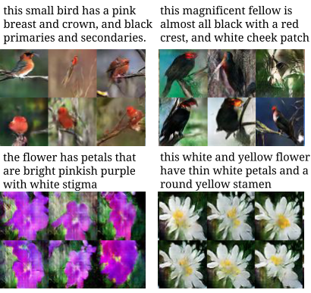
What’s wrong with GANs?
A careful balance discriminator and the generator
Mode collapse: Low output diversity
A careful design of the network architecture
No loss metric that correlates with the generator’s convergence and sample quality
Unstable of the optimization process

Slide 3
Wasserstein GAN (WGAN)
A careful balance discriminator and the generator
Mode collapse: Low output diversity
A careful design of the network architecture
No loss metric that correlates with the generator’s convergence and sample quality
Unstable of the optimization process

Slide 4
Takeaways of WGAN
No log term
Clip the parameter

Slide 5
Vanishing Gradient
When the discriminator successfully rejects generator samples with high confidence, the generator’s gradient vanishes. (Goodfellow 2016)
Take gradient w.r.t. D(x)
Insert back

Slide 6
Jensen–Shannon divergence
is almost a constant!

Slide 7
Learning parallel lines

Slide 8
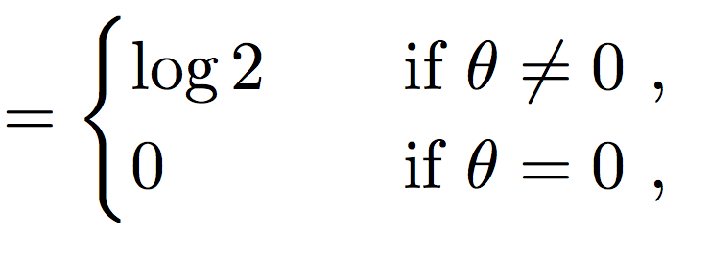
Learning parallel lines

Slide 9
Wasserstein Distance

Slide 10
Kantorovich-Rubinstein duality
f : R → R is called K-Lipschitz continuous if there exists a positive real constant K such that, for all real x₁ and x₂,

Slide 11
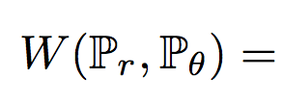
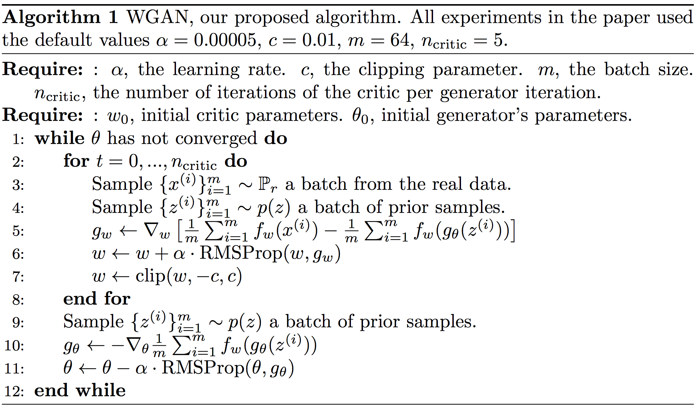
Parameterize f
K-Lipschitz?
Clip the weights to a fixed box (say [−0.01, 0.01])

Slide 12
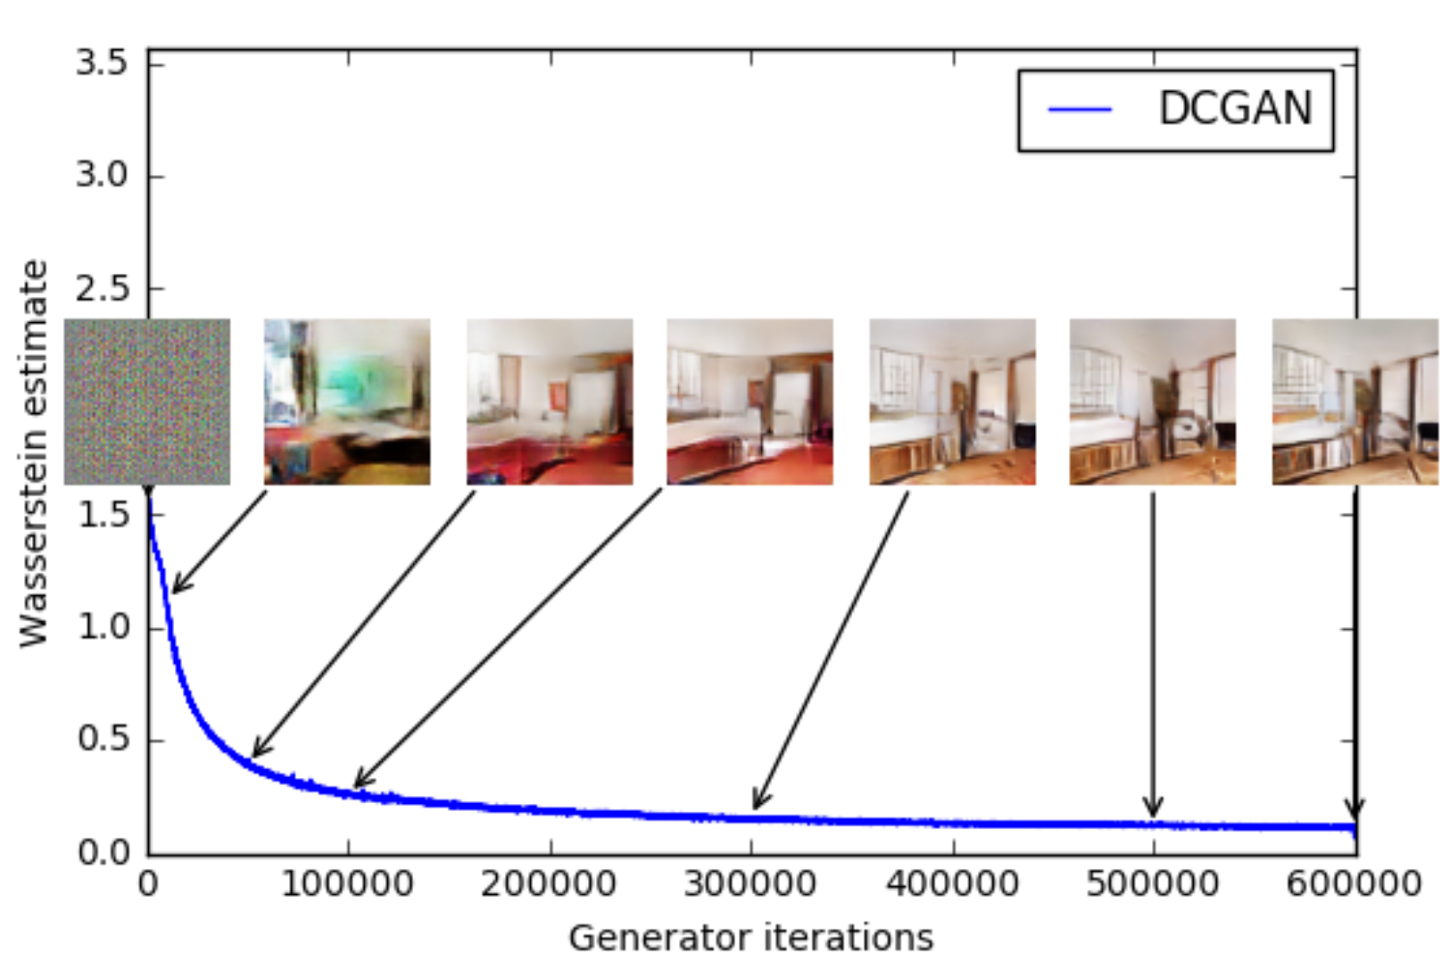
Meaningful loss metric

Slide 13
Compare with DCGAN

Slide 14
Without Batch Normalization

Slide 15
With simpler architecture

Slide 16
References
Martin Arjovsky, Léon Bottou; Towards Principled Methods for Training Generative Adversarial Networks, ICLR2017
Martin Arjovsky, Soumith Chintala, Léon Bottou; Wasserstein GAN, arXiv

