Slide 1
Probabilities and decision theory

Slide 2
Probabilities of filter responses
We develop the key ideas of decision theory by addressing the specific task of edge detection
We introduce the probabilities of filter responses by describing a classical experimental finding about natural image statistics.
$$\frac{dI}{dx} or \frac{d^{2}I}{dx^{2}}$$
The histograms of these derivative filters are very similar from image to image (Simoncelli & Olshausen, 2001)

Slide 3
Edge detectors/ texture detectors and decisions
Whether an image patch at position x contains an edge
Edge: the boundary of an object or a strong
texture boundary

Slide 4
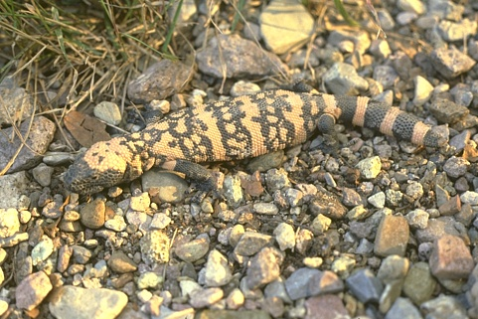
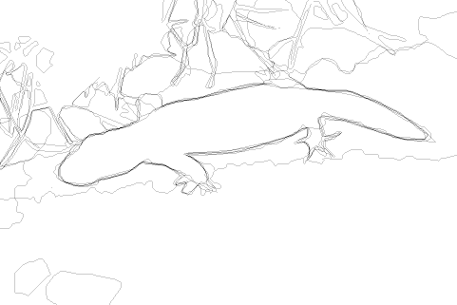
Edge detectors/ texture detectors and decisions
？
changes correspond to object boundaries
changes caused by texture patterns textures

Slide 5
Edge detectors/ texture detectors and decisions
The simplest way is to threshold the response so that an edge signaled if the filter response is larger than a certain threshold value
Q: 1. But what should that threshold be?
2. How do we do a trade-off to balance false negative errors with false positive errors?
3. how can we combine that filter responses in an optimal manner?
4. How can we formulate the intuition that some filters give independent evidence, while others do not?

Slide 6
Decision theory
Decision theory gives a way to address these issues.
The theory was developed as a way to make decisions in the presence of uncertainty.

Slide 7
Filters
The evidence for the presence of an edge: $f(∙)$ -a single filter
For each pixel $x$, we have intensity $I(x)$ and a variable $y\left(x\right)∈\{1,−1\}$ ($y=1$: edge, $y=−1$: non-edge), filter responses $f(I\left(x\right))$
An example of $f(∙)$ : $\left|\vec{∇}I\left(x\right)\right|=\sqrt{{\frac{dI}{dx}}^{2}+{\frac{dI}{dy}}^{2}}$

Slide 8
Conditional probability distributions
We use a benchmarked data set to learn conditional probability distributions for the filter response $f(I)$ conditioned on whether there is an edge or not:
Each distribution is estimated by computing the histogram of the filter response by counting the number of times the response occurs within one of N equally spaced bins and normalizing by dividing by the total number of responses.
Notes:
The histograms for P(f (I )jy = 1) and P(f (I )jy = 􀀀1) are
computed from the lter responses on the points labeled as edges
ff (I (x)) : y(x) = 1g and not-edges ff (I (x)) : y(x) = 1g respectively.

Slide 9
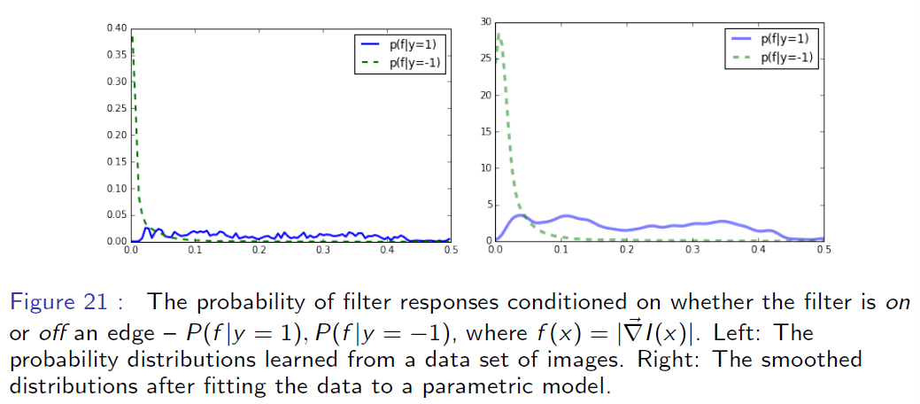
Figure for conditional distributions

Slide 10
Statistical edge detection
At each pixel $x$ we compute $f(I(x))$and calculate the conditional distributions $P(f(I(x))|y = 1)$and $P(f (I (x))|y=−1)$.
These distributions give local evidence for the presence of edges at each pixel.

Slide 11
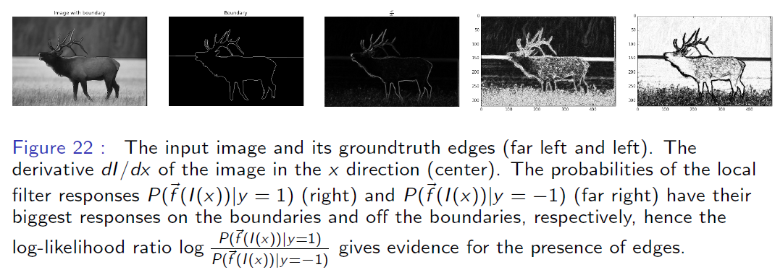
Statistical edge detection figure

Slide 12
Log-likelihood ratio
The log-likelihood ratio: $\log{\frac{P(f(I(x))|y=1)}{P(f(I(x))|y=−1)}}$ gives evidence for the presence of an edge in image $I$ at position $x$.
A decision rule $α\left(x\right):$
$α\left(x\right)=1$, if $\log{\frac{P(f(I(x))|y=1)}{P(f(I(x))|y=−1)}}>0$,
$α\left(x\right)=−1$, if $\log{\frac{P(f(I(x))|y=1)}{P(f(I(x))|y=−1)}}<0$
$$α\left(x\right)=\arg{\max_{y∈\{1,−1\}}{y\log{\frac{P(f(I(x))|y=1)}{P(f(I(x))|y=−1)}}}}$$

Slide 13
Decision rule
This rule gives perfect results (i.e., is 100% correct) if the two distributions do not overlap, i.e., for all $I$, if
$$P\left(f\left(I\left(x\right)\right) | y=1\right)P\left(f\left(I\left(x\right)\right) | y=−1\right)=0$$
A more general log-likelihood ratio test that depends on a threshold $T$
$$α\left(x\right)=\arg{\max_{y∈\{1,−1\}}{y\{\log{\frac{P(f(I(x))|y=1)}{P(f(I(x))|y=−1)}}}}−T\}$$

Slide 14
Two types of mistakes
By varying$T$we get different types of mistakes
false positives: non-edge stimuli which the decision rule mistakenly decides to be an edge
false negatives: edge stimuli which are mistakenly classified as not being edges
Increasing the threshold $T$ reduces the number of false positives but at the cost of increasing the number of false negatives, while decreasing $T$ has the opposite effect.

Slide 15
Decision theory and trade-offs
Making a decision requires a trade-off between these two types of errors.
Bayes decision theory says this trade-off should depend on two issues:
the prior probability that the image patch is an edge
the loss if we make a mistake
Notes:
Making a decision requires a trade-o between these two types of errors. Bayes
decision theory says this trade-o should depend on two issues: rst, the prior
probability that the image patch is an edge. Statistically most image patches
do not contain edges, so we would get a small number of total errors (false
positives and false negatives) by simply deciding that every image patch is
non-edge. This would encourage us to increase the threshold T (to 􀀀1 so
that every image patch would be classied as non-edge). Second, we need to
consider the loss if we make a mistake. If our goal is to detect edges, then we
may be willing to tolerate many false positives provided we keep the number of
false negatives small. This means we choose a decision rule, by reducing the
threshold T, so that we detect all the real edges but also output \false edges,"
which we hope to remove later by using contextual cues.

Slide 16
Combining multiple cues for edge detection
Combining several different filters $\{f_{i} (∙)|i = 1,…,M\}$ to detect an edge by estimating the joint response of all the filters $P(f_{1},f_{2},…|y) = P(\{f_{i}\left(I \left(x\right)\right)\}|y)$ conditioned on whether the image patch $I$ at $x$ is an edge $y=1$or not an edge $y=−1$.
$$α_{T}\left(I(x)\right)=\arg{\max_{y∈\{1,−1\}}{y\{\log{\frac{P(\{f_{i}\left(I \left(x\right)\right)\}|y=1)}{P(\{f_{i}\left(I \left(x\right)\right)\}|y=−1)}}}}−T\}$$

Slide 17
Drawbacks
The joint distributions require a large amount of data to learn
The joint distributions are “black boxes” and give no insight into how the decision is made
Solution: by studying whether the different filters are statistically independent

Slide 18
Combining cues with statistical independence
The response of the filters is statistically independent if:
$$P\left(\left\{f_{i}\left(I \left(x\right)\right)\right\} | y\right)=\prod_{i}{P\left(f_{i}\left(I \left(x\right)\right) | y\right)}$$
$$α_{T}\left(I(x)\right)=\arg{\max_{y∈\{1,−1\}}{y\{\sum_{i}{\log{\frac{P(f_{i}\left(I \left(x\right)\right)|y=1)}{P(f_{i}\left(I \left(x\right)\right)|y=−1)}}}}}−T\}$$
Each filter gives a "vote," which can be positive or negative, and the decision is based on the sum of these votes.

Slide 19
Combining cues with conditional independence
Very few filters are statistically independent, e.g., the response of each filter will depend on the total brightness of the image patch
an additional filter: $f_{0}\left(I \left(x\right)\right)$ measures the overall brightness
$$P\left(\left\{f_{i}\left(I\left(x\right)\right)\right\},f_{0}\left(I\left(x\right)) | y\right)\right)=P\left(f_{0}\left(I\left(x\right) | y\right)\right)\prod_{i}{P(f_{i}\left(I\left(x\right)\right)|f_{0}\left(I\left(x\right)\right),y)}$$

Slide 20
Combining cues with conditional independence
$α_{T}\left(I(x)\right)=\arg{\max_{y∈\{1,−1\}}{y\{\log{\frac{P\left(f_{0}\left(I \left(x\right)\right) | y=1\right)}{P\left(f_{0}\left(I \left(x\right)\right) | y=−1\right)}}+\sum_{i}{\log{\frac{P(f_{i}\left(I \left(x\right)\right)|f_{0}\left(I\left(x\right)\right),y=1)}{P(f_{i}\left(I \left(x\right)\right)|f_{0}\left(I\left(x\right)\right), y=−1)}}}}}−T\}$
Note that the arguments here are general and do not depend on the type of filters $f_{i} (∙)$or whether they are linear or nonlinear.
It has, for example, been suggested that edge detection is performed using the energy model of complex cells (Morrone & Burr, 1988).

Slide 21
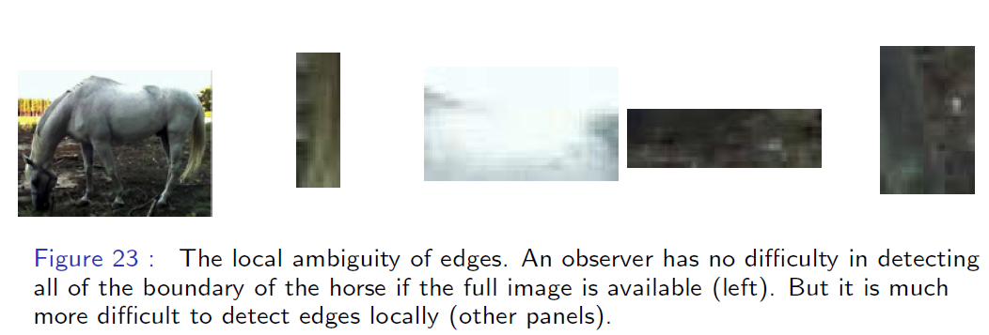
Ambiguity of edges figure
local evidence for edges is often highly ambiguous

Slide 22
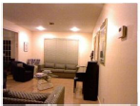
Learning edges by context information
Spectral component (gPb - Arbeláez et al. PAMI 11)
Sparse code gradients (SCG – Ren&Bo, NIPS 12)

Slide 23
Learning edges by sophisticated models
Structured Forest (SE – Dollar&Zitnick ICCV 13, PAMI 15)

Slide 24
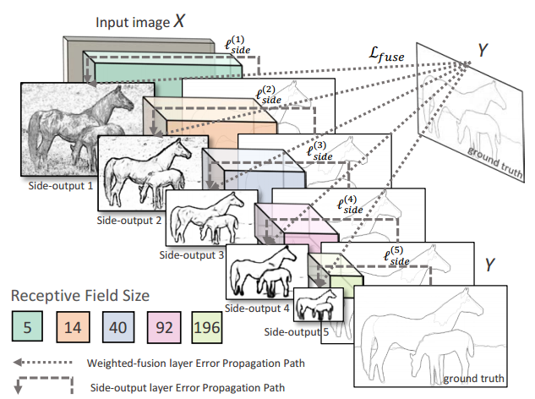
Learning edges by deep networks
DeepContour (Shen et al., CVPR 2015)
Holistically-Nested Edge Detection (Xie&Tu, ICCV 2015)

Slide 25
Classification for other visual tasks
The same approach can be applied to other visual tasks. For example, consider using local filter responses to classify whether the local image patch at $x$ is "sky," "vegetation," "water," "road," or "other"). We denote these by a variable $y∈𝒴$
$α\left(I\left(x\right)\right)=\arg{\max_{y∈𝒴 }{P\left(\left\{f_{i}\left(I \left(x\right)\right)\right\} | y\right)}}T_{y}$

Slide 26
Classifying other image classes

