Slide 1
Binocular Stereo

Slide 2
Goal of Binocular Stereo
Estimate Dpeth.
Leonardo da Vinci
Wheatstone.
Aerial Photography.
Julesz Random Dot Stereograms.
Detect objects in camouflage?

Slide 3
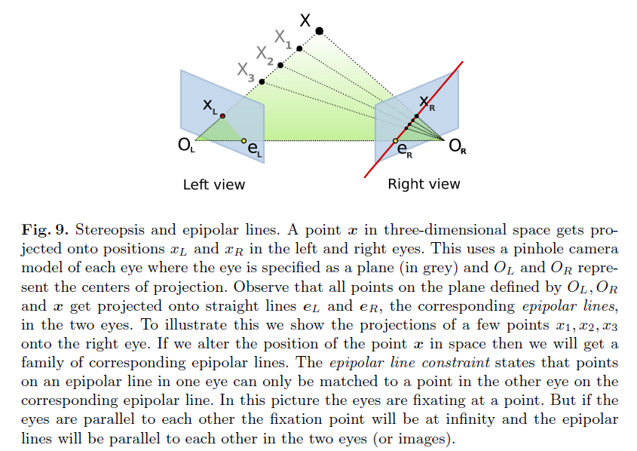
Geometry of Stereo: Depth by Triangulation
Estimate Depth by Trigonometry:

Slide 4
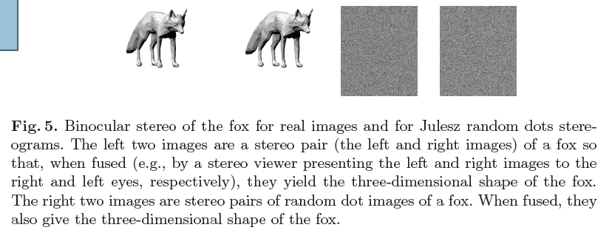
The Correspondence Problem.
Bela Julesz Random Dot Stereograms:

Slide 5
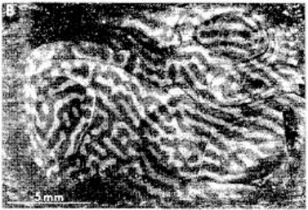
Ocular Dominance Columns
Stereo in V1?

Slide 6
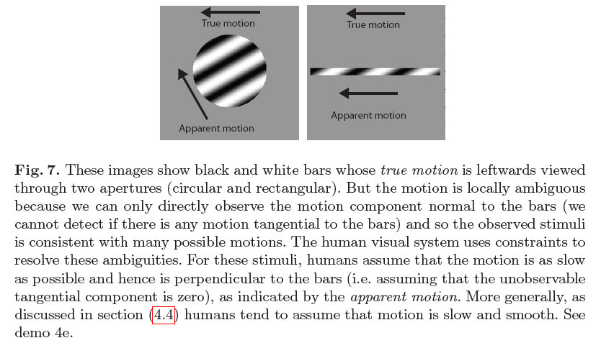
Motion Estimation
Ambiguities – the need for priors.

