Slide 1
Latkes vs. Hamantaschen
Prof. Jason Eisner
Department of Computer Science
JHU Debate – Dec. 4, 2024
Notes:
[These speaker notes are roughly what I said or at least wanted to say. It may be a bit hard to read the notes while animating the slides, though!]

Slide 2
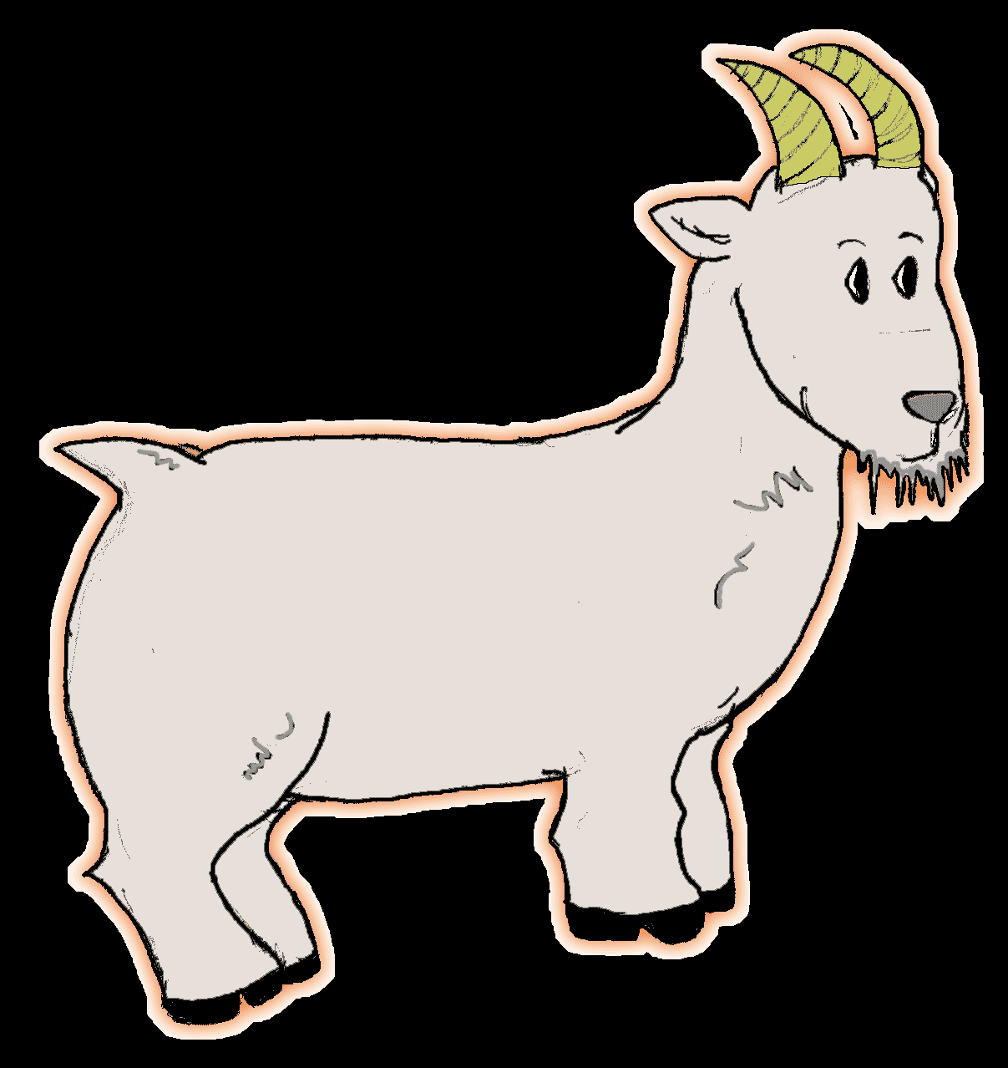
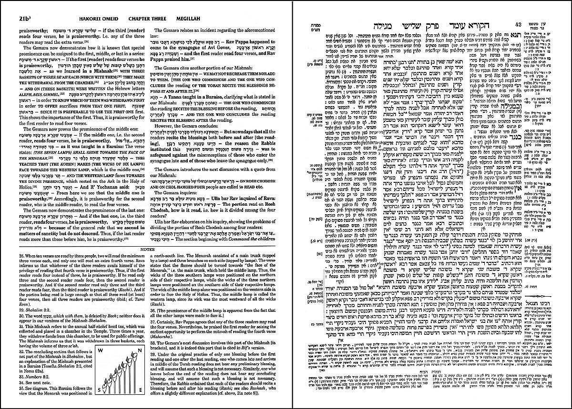
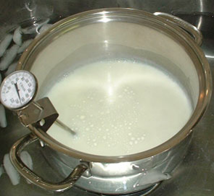
Simplicity vs. Complexity
Jewish
Notes:
As the Talmud illustrates, Judaism has no use for simplicity. Especially when it comes to food.
[goat falls into seething pot of unidentified milk]

Slide 3
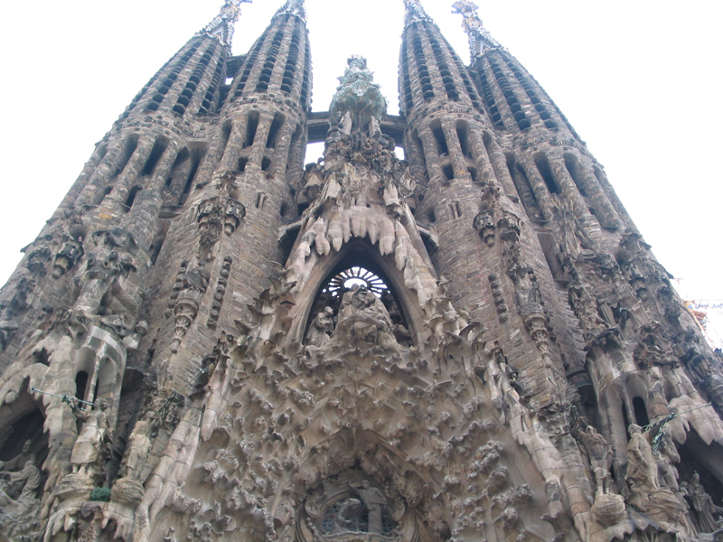
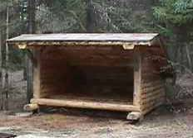
Simplicity vs. Complexity
Jewish
Notes:
The Mind of God is so complex that if God said that [the hut appears],
God must surely have meant something like this [up springs the Gaudiesque architecture of halacha].

Slide 4
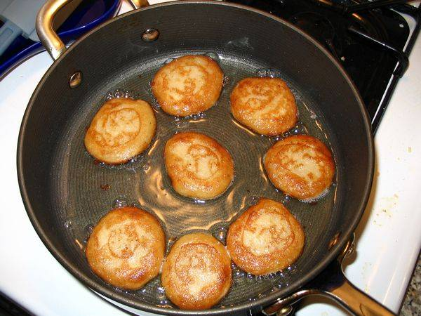
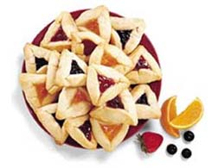
Simplicity vs. Complexity
Jewish
Establishing hamantaschic superiority:
Informational complexity
Linguistic complexity
Computational complexity
Notes:
Tonight I’m up against not 1, not 2, but 3 distinguished latkediks.
So I will thrice demonstrate the superiority of the hamantasch … by proving that it’s a more complex foodstuff, by the criteria of the three disciplines I know best: math, linguistics, and computer science.

Slide 5
Informational Complexity
What is the information content of each food?
(measured in bytes)
Notes:
First, what’s the informational complexity of each food?
Is it really true that there are more bytes in a hamantasch?
This is useful to know if you have to smuggle a long coded message out of the ghetto in your lunchbox.

Slide 6
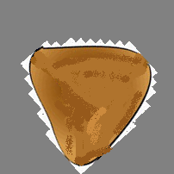
Informational Complexity
Asymmetries
Alas, orientation is not reliably transmitted
heads
tails
Notes:
It’s tempting to encode this message through the orientation of the hamantasch [different orientations appear],
since with a latke, you never really know which end is up, do you? [latkes spin inconclusively]
But there aren’t that many distinguishable orientations, and the distinctions tend to be lost in transit.

Slide 7
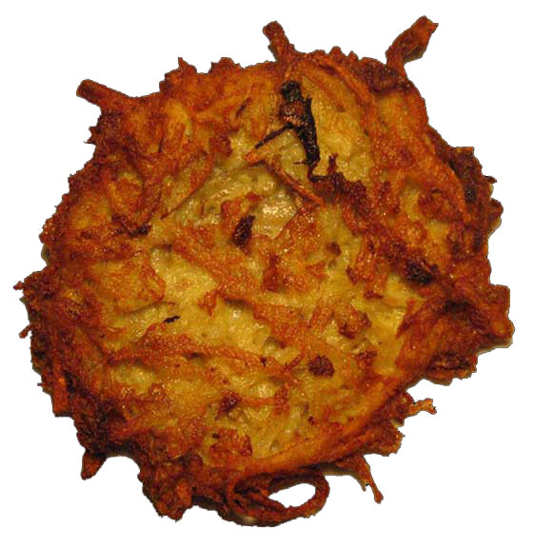
Fine-grained Informational Complexity
(x₁,y₁)
(x₂,y₂)
Strands are unordered:
n strands of potato
* 4 real #s per strand
* k bits recovered per real
= 4kn bits?
Notes:
So let’s turn to fine-grained structure.
We may model the latke as a unit disk [appears] populated by n linear strands of potato [appear].
By carefully positioning the endpoints of a strand, we can transmit 4 real-valued coordinates [shown].
Let’s suppose that the unlucky recipient of the latke – who would presumably have preferred a dessert – can recover each coordinate up to k bits of fixed-point precision.
So this looks like about 4kn bits in toto.
It’s actually not quite that good, since the strands are undirected and you can’t specify an order among them.
But it’s pretty close, about this [complicated equation], at least if k is large enough that the coordinate grid is only sparsely populated.
[PROF SCHEINERMAN (rebutting in-line): You have to mod out by the dihedral group.
PROF EISNER (under the protection of the ≈ sign): Well, you can determine the orientation by the color gradient.]

Slide 8
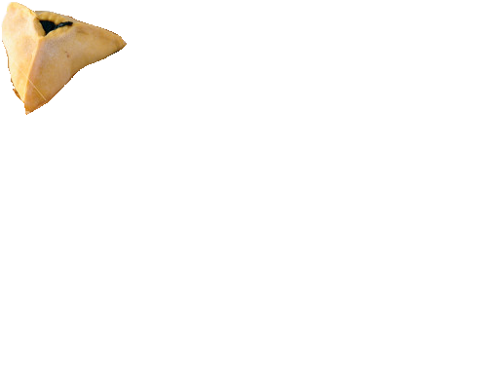
Fine-grained Informational Complexity
(0,0,1,0)
(0,0,0,1)
(0,1,0,0)
(each point’s coords sum to 1)
(1,0,0,0)
n poppy seeds
* 3 real #s per seed
* k bits recovered per real
Notes:
In contrast, the hamantasch is an ideal tetrahedron occupied by n points suspended in honey.
As the tetrahedron is isomorphic to a 3-simplex, each poppy seed transmits 4 positive real coordinates -
but since they must sum to 1, we actually get only 3 degrees of freedom.

Slide 9
Fine-grained Informational Complexity
(0,0,1,0)
(0,0,0,1)
(0,1,0,0)
(x₁,y₁)
(each point’s coords sum to 1)
(x₂,y₂)
(1,0,0,0)
n potato strands
* 4 real #s per strand
* k bits recovered per real
n poppy seeds
* 3 real #s per seed
* k bits recovered per real
≥
Notes:
Now, it may seem that this 4 to 3 ratio is some kind of victory for the latke,
as if the latke contained more good bits.

Slide 10
Fine-grained Informational Complexity
(0,0,1,0)
(0,0,0,1)
(0,1,0,0)
(x₁,y₁)
(each point’s coords sum to 1)
(x₂,y₂)
(1,0,0,0)
n potato strands
* 4 real #s per strand
* k bits recovered per real
n poppy seeds
* 3 real #s per seed
* k bits recovered per real
≤
Notes:
But is n the same? No, my friends, it is not. [≥ sign slowly spins around to point the other way]
The delicate poppy seed is so dainty that a single hamantasch can contain myriads … perhaps myriads of myriads.
Who knows how many pinheads dance in the bread of an angel?
Whosoever consumeth the hamantasch digesteth more information (and is therefore the better Jew).

Slide 11
Linguistic Complexity
Gemetria
The Bible Code
= 10
= 22
+ 50-point length bonus!
Notes:
Now, we’ve been talking about coded messages.
In Judaism, this idea may be more familiar in a linguistic context.
[contestant words appear] So let’s start by observing that HAMANTASCHEN not only enjoy an irregular plural (making them more complex) and twice as many letters, but that those letters are on average rarer, so that HAMANTASCHEN earns more than twice the Scrabble score [scores appear].
You know, come to think of it … ChatGPT fix my slide … [“50-point length bonus” bounces in] More than seven times the Scrabble score!

Slide 12
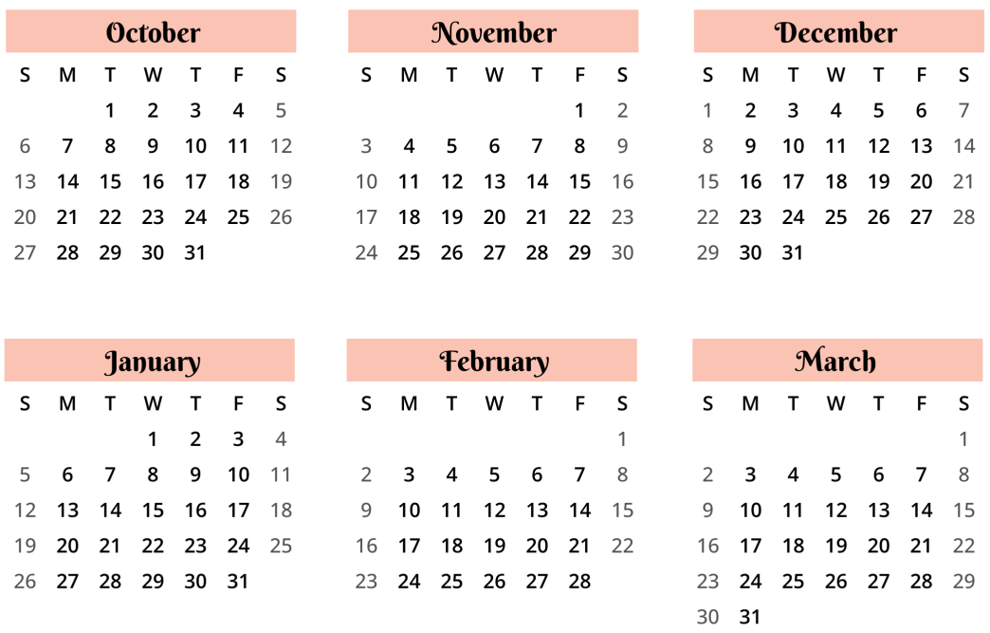
Point of Order …
2024-2025
Chanukah
This debate
Purim
Notes:
Let me digress for a moment, since my attention is drawn by this premature menorah, with its bright flames dancing gaily.
The suspicious timing of this debate has not escaped us partisans of hamantaschkeit.
We are not surprised that the well-oiled latke lobby is up to its usual greasy tricks.
And not just to infuse their fetish food with a sheen of seasonal appropriateness, but also to deflect attention from its nefarious origins.

Slide 13
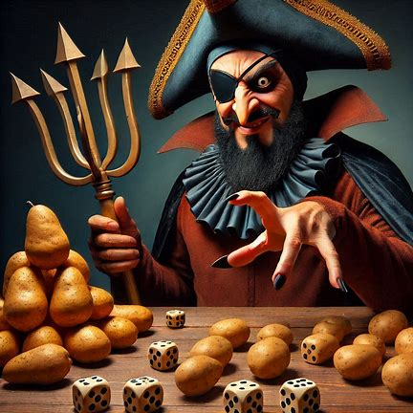
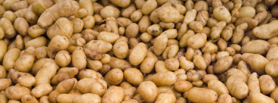
Purim, a.k.a. the Feast of Lots
Notes:
Purim is known as the Feast of Lots because on that day, Haman cast lots to choose the day on which he would exterminate the Jews. He thought we were small potatoes, so I imagine that’s what he used – little lots, each known as a lot-ke.

Slide 14
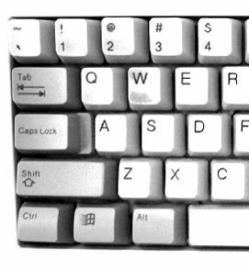
Purim, a.k.a. the Feast of Lots
Notes:
Purim is known as the Feast of Lots because on that day, Haman cast lots to choose the day on which he would exterminate the Jews. He thought we were small potatoes, so I imagine that’s what he used – little lots, each known as a lot-ke.
We can see a trace of this murderous history in the fact that ONE LATKE [appears] is an anagram of [gasp] AKELETON !! [appears] – obviously a scribal error [appears alongside helpful keyboard diagram].

Slide 15
Purim, a.k.a. the Feast of Lots
Notes:
Meanwhile, the noble HAMANTASCHEN save the day when they CHASTEN HAMAN [appears].
Well: having properly chastened our villain and his evil spud sidekicks, it remains to satisfy the computer scientists.

Slide 16
Computational Complexity
∈ NC
∈
NP
⊆
(“Nosh Chanukah”)
(“Nosh Purim”)
decidable in polylogarithmic time with a polynomial number of processors
decidable in polynomial time with a nondeterministic processor
Notes:
I believe the relevant computational complexity classes are NC and NP, although it’s not well known that these stand for “nosh chanuKAH” and “nosh puRIM.” From the definitions [which appear], it’s clear – and Wikipedia will bear me out on this! – that NP is the more complex class [⊆ appears].

Slide 17
Computational Complexity
∈ NC
∈
NP
⊆
(“Nosh Chanukah”)
(“Nosh Purim”)
NP is more computationally complex!
But don’t want to prove that is NP-hard
Notes:
Now, the hamantasch is only one member of the class.
So this doesn’t quite imply that the hamantasch in particular is more complex
(unless it’s NP-hard – and I like them a bit softer than that).

Slide 18
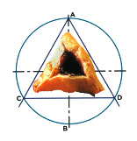
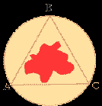
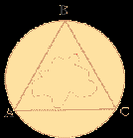
Computational Complexity
So let’s do a direct reduction:
This is a poppynomial reduction
Implies existence of a gastric reduction
If you can digest a hamantasch, you can digest a latke
Therefore, the hamantasch is the more complex carbohydrate
Notes:
So let’s try to proceed by a direct reduction. It’s not too hard.
Given a hamantasch, simply fold down the sides, dispose of the filling [licks fingers] – mmm! – and you have essentially a latke, by poppynomial reduction [appears]. It follows that if you can digest a hamantasch, you can digest a latke – or at least this latke -- and therefore, the hamantasch is the more complex carbohydrate.
[Note to reader: As phrased above, this argument is poppycock; it hinges on a pun between existential and universal readings of “latke.” However, it legitimately shows that the minimum complexity of a hamantasch is at least as great as the minimum complexity of a latke … at least if one accepts a circle of jam-stained dough as a variety of latke.]

Slide 19
Conclusions
Judaism loves complexity
Hamantaschen are more complex
Informational complexity
Linguistic complexity
Computational complexity
And they’ll enhance your math!
Notes:
In summary, Judaism loves complexity, and hamantaschen are more complex, as I’ve proved to you repeatedly.
I hope I’ve not only convinced you which snack is superior, but also enhanced your math! [appears]

