Slide 1
On the Complexity and Typology of Inflectional Morphological Systems
Ryan Cotterell, Christo Kirov, Mans Hulden and Jason Eisner
Notes:
Hey! I’m Ryan and I am going to present our paper on the complexity and typology of inflectional morphological systems. This is joint work with my amazing colleagues, Christo Kirov, Mans Hulden and Jason Eisner.
Are any of you jetlagged? I’m pretty jetlagged. It took me 30 hours to get here. So, it would really help me get into this talk if we had a bit of audience participation.

Slide 2
What’s your native language?
Notes:
Could all those members of the audience whose native language is not English raise their hand? That is, did you grow up speaking something other than English at home?
Great! That’s most of the audience.

Slide 3
Do you think your native language more complex than English?
Notes:
This talk is about linguistic complexity. To start, I’m interested in how many of those people who raised their hands think their native language is more complex than English.

Slide 4
Audience Poll
Question: Who thinks their native language is more complex than English?
Notes:
In fact, I’d like to poll the audience again. Raise your hand if you think your native language is more complex than English? No need to participate if you speak English natively.

Slide 5

Loading…
Notes:
So, the insta poll is loading

Slide 6
Instant Results
Notes:
Wow! It looks like about 83% of you said yes!

Slide 7
What makes your native language more complex than English?
Notes:
Since the overwhelming majority of you think your native language is more complex than English, does anyone want to volunteer an answer about why you think that? Any volunteers? How about you there, in the front?
<JASON>
I see, so could I summarize what your point as <click> more morphology makes a language more complex?

Slide 8
More Morphological Variants = A More Complex Language
I agree: a lot of morphological variants can make a language “difficult”:
  Mark Twain said it best: “I’d rather decline two drinks than one German adjective.”
Then, look at how simple English is!
  Your average verb has four inflections: run, runs, ran, running
Nouns and adjectives don’t inflect in English according to case
  The adjective good has one inflection

Slide 9
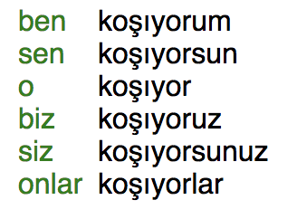
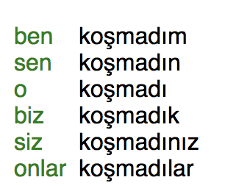
In Comparison: The Turkish Verb
koşmak = Turkish verb ”to run”
  (partial) paradigm →
Tense, mood, evidentiality … marked through morphology
  100+ forms in Turkish!
Archi (Kibrik 1998) has 1.5 million verb forms
  It’s very, very agglutinative
This makes a language more complex!
Notes:
Mention that even more forms are marked, but not in the partial paradigm
Give a short definition of a paradigm

Slide 10
Number of Forms is Only One
Dimension of Morphological Complexity
There are (at least) two types of morphological complexity
  Type 1: how big are the paradigms? (seen before)
  Type 2: how irregular are the paradigms?
Ackerman and Malouf (2013) introduce the technical jargon
  Enumerative Complexity (E-Complexity)
  Integrative Complexity (I-Complexity)
Notes:
2013

Slide 11
English versus Turkish: # Forms
English
  4 verbal slots
  2 nominal slots
  1 adjectival slot
Turkish
  350 verbal slots
  8 nominal slots
  1 adjectival slots
7 Total
358 Total
Turkish is more morphologically complex under # forms per verb
Notes:
TODO:
Show pictures of the paradigms
Show winner
State that it’s simple
Show cup

Slide 12
English Versus Turkish: Irregularity
English
  224 irregular verbs
  10 irregular nouns
  0 irregular adjectives
Turkish
  1 irregular verb
  0 irregular nouns
  0 irregular adjectives
234 Total
1 Total
English is more morphologically
complex under amount of irregularity

Slide 13
Good Linguistic Question:
How do the # morphological variants and morphological irregularity interact?
What’s This Paper About?
Notes:
4:30

Slide 14
Plotting English and Turkish Verbs
English
Turkish
Irregularity
# Forms
Notes:
English has fewer forms per verb, but they’re more irregular.

Slide 15
What about the Rest of the World’s Languages? (For which we have data)
No Languages Here
Irregularity
# Forms
Notes:
If a language has only 10 or so ways to inflect each verb, then it can tolerate an irregularity of up to 1.6. I’ll say later how we quantify that.
But as the number of inflections increases, so does the maximum irregularity.
This line is the Pareto frontier: it’s a decreasing curve that lies above all the points, and it’s the tightest upper bound of that sort.
FIX CURVE!

Slide 16
What about the Rest of the World’s Languages? (For which we have data)
No Languages Here
Irregularity
# Forms
Notes:
If a language has only 10 or so ways to inflect each verb, then it can tolerate an irregularity of up to 1.6. I’ll say later how we quantify that.
But as the number of inflections increases, so does the maximum irregularity.
This line is the Pareto frontier: it’s a decreasing curve that lies above all the points, and it’s the tightest upper bound of that sort.
FIX CURVE!

Slide 17
What about the Rest of the World’s Languages? (For which we have data)
No Languages Here
Irregularity
# Forms
Notes:
If a language has only 10 or so ways to inflect each verb, then it can tolerate an irregularity of up to 1.6. I’ll say later how we quantify that.
But as the number of inflections increases, so does the maximum irregularity.
This line is the Pareto frontier: it’s a decreasing curve that lies above all the points, and it’s the tightest upper bound of that sort.
FIX CURVE!

Slide 18
What about the Rest of the World’s Languages? (For which we have data)
Pareto Frontier
No Languages Here
Irregularity
# Forms
Notes:
If a language has only 10 or so ways to inflect each verb, then it can tolerate an irregularity of up to 1.6. I’ll say later how we quantify that.
But as the number of inflections increases, so does the maximum irregularity.
This line is the Pareto frontier: it’s a decreasing curve that lies above all the points, and it’s the tightest upper bound of that sort.
FIX CURVE!

Slide 19
What about the Rest of the World’s Languages? (For which we have data)
Pareto Frontier
No Languages Here
Irregularity
# Forms
Notes:
If a language has only 10 or so ways to inflect each verb, then it can tolerate an irregularity of up to 1.6. I’ll say later how we quantify that.
But as the number of inflections increases, so does the maximum irregularity.
This line is the Pareto frontier: it’s a decreasing curve that lies above all the points, and it’s the tightest upper bound of that sort.
FIX CURVE!

Slide 20
Scientific Hypothesis about Language
Use machine learning techniques to test hypothesis about Language
Morphological systems can have either a lot of forms or lot of irregularity
  But not both!
Why? Speculative reason: memorizing a lot of irregulars would tax human memory
No Languages Here

Slide 21
Chinese is Low on Both Dimensions of Morphological Complexity
Morphology in a language is not necessary!
Let’s look at the Chinese verb “to drink”
  drink = 喝
  drinking = 喝
  drank = 喝
Look mommy, no inflection!
Notes:
7:30

Slide 22
Our Hypothesis Again
Inflectional, morphological systems have a lot of forms, or a lot irregularity, but not both
No Languages Here
Irregularity
# Forms
Notes:
8:00

Slide 23
A Paired Permutation Test
There appears to be a trend, but is it significant?
  Is the upper right-hand corner more empty that it would be by chance?
New Significance Test
  Keep x-axis in tact, shuffle y-axis
  compare area under the Pareto curve
  Non-parametric test
No Languages Here
Notes:
To what extent are these things anti-correlated that leaves the upper-right-hand corner blank. We destroy the association by randomly permuting the i-complexities. That is, we leave the x-coordinates alone
and randomly permute the y-coordinate. We can use the same test for mutual information, but our test statistic is area under the curve
SAY SHUFFLE

Slide 24
Random Morphological Trade-Off
Irregularity
# Forms
Notes:
TODO: change color.

Slide 25
Random Morphological Trade-Off
Irregularity
# Forms

Slide 26
Random Morphological Trade-Off
Irregularity
# Forms

Slide 27
Scientific Finding
Gap in the upper right-hand size with p < 0.05
No Languages Here
Irregularity
# Forms
Notes:
There area under the curve is not that small, so it only gets to be that small is probably not due to chacne. ceugjijjejvnulhffknfjkjtdvnlvkkd

Slide 28
Caution: Limited # Of Languages
We need to be very cautious about reporting the results!
The languages are not i.i.d.
  Some of them are genetically related
  Focus on Western European Languages
We have a small sample of size of languages
  There might be unobserved counterexamples
  For this sample, the Pareto frontier leaves an unusually large gap in the upper right

Slide 29
Technical Contribution:
Operationalizing Morphological Irregularity
Notes:
11:00

Slide 30
Where did the y-axis come from?
What do those numbers mean?
No Languages Here
Irregularity
# Forms
Notes:
8:00

Slide 31
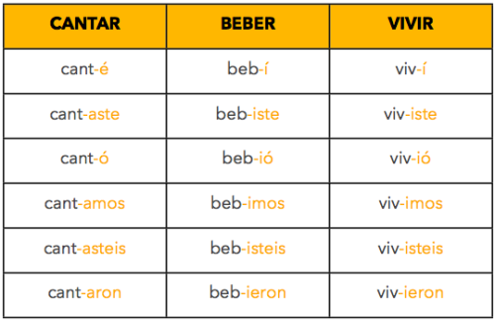
What’s an Irregular Verb?
TL;DR: some grammarian said so
Example: Spanish has three types of regular verbs
  ar, er, ir
The rest are “irregular”
  Why???
Are they equally irregular?
  Or are some verbs more irregular than others?
Notes:
But what is an irregular verb? Like, rigorously? Anyone want to volunteer to answer? Just kidding, I think one planted question is enough during an ACL talk.
First among irregulars – an animal farm situation

Slide 32
New Insight: We will tackle morphological irregularity probabilistically

Slide 33
Regularity = Predictability
For each language
  Step 1: Build a really good generative probability model p of the morphological paradigm
  Step 2: Train its parameters on some data
  Step 3: Irregularity = -log p(held-out data)

Slide 34
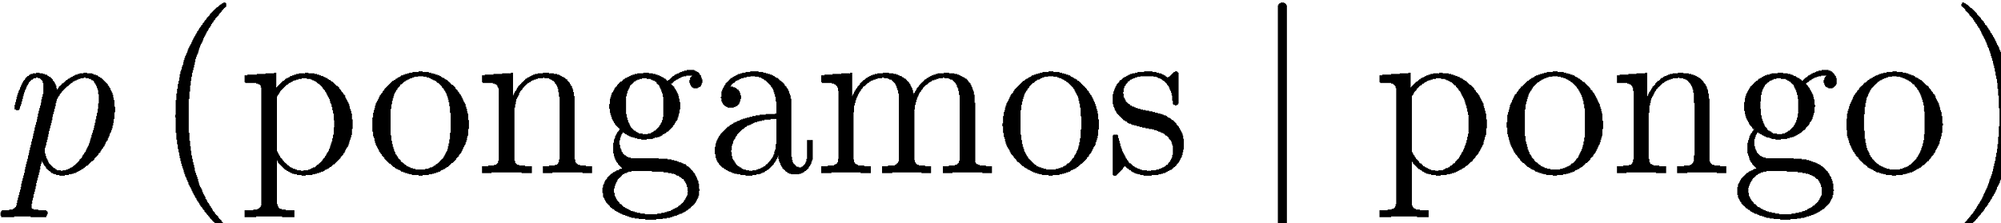
Morphological Reinflection
Start with pair-wise probability distributions
In NLP, this task is known as morphological reinflection
  Three shared tasks: SIGMORPHON (2016), CoNLL (2017, 2018)
  Cotterell et al. (2016,2017) for overview of the results
  State of the art: LSTM seq2seq model – same as MT
1ps;prs;sbjv;pl
1ps;prs;ind;sg

Slide 35
Sequence-to-Sequence Model
x = pongas
y = pongo
p
o
n
g
a
s
LSTM
p
o
n
g
o
#
p(y | x) reads x, then stochastically emits
chars of y, 1 by 1, like a language model
Notes:
And why are aliens so cute?
They just gobble up the red string with their LSTM neural network and they digest it as they go along.
Then they poop out the blue string. Or different blue strings with different probabilities.
There’s no Markov property here, so you have to find the best blue string by beam search.

Slide 36
Arrange into a Bayesian Network
poner
puso
pongo
pondría
pusimos
pusieron
pongamos

Slide 37
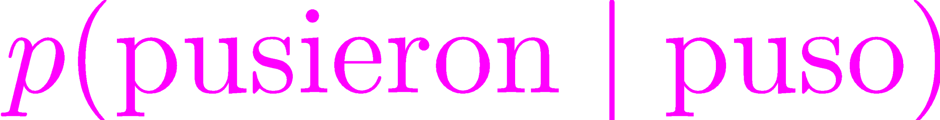
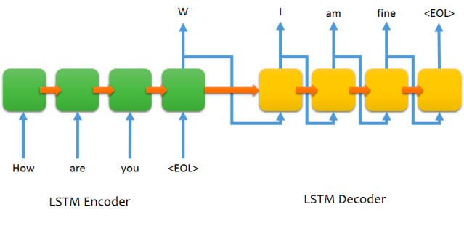
Neural Graphical Model Over Strings
poner
puso
pongo
pondría
Each conditional is a LSTM-based seq2seq model!
pusimos
pusieron
pongamos
Cotterell et al. (2017) @ EACL 2017
Notes:
No, like a standard graphical model that you may be used to, because each conditional is an LSTM-based sequence-to-sequence model!
CITE DREYER

Slide 38
Many Possible Networks
pusieron
pondría
pusimos
poner
puso
pongo
pongamos

Slide 39
How to Choose Best Tree?
Standard structure learning problem in graphical models
Strategy: Tie parameters among all conditionals
  Conditionals for every possible tree trained together
Inspired by Chow-Liu Algorithm
  Use Chu-Liu-Edmonds
  Finds optimal directed spanning tree in time
Notes:
16:00

Slide 40
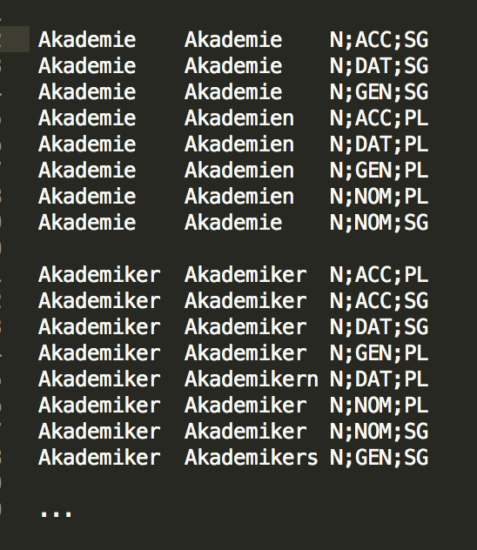
Experimental Languages
Cross-linguistically Compatible Labels
Data from the UniMorph (Kirov et al. 2018)
Selected languages with ”enough” training examples
Verbal Paradigms:
  23 languages / 3 families
Nominal Paradigms
  31 languages / 3 families
German Nominal Paradigms
Notes:
mention neural models

Slide 41
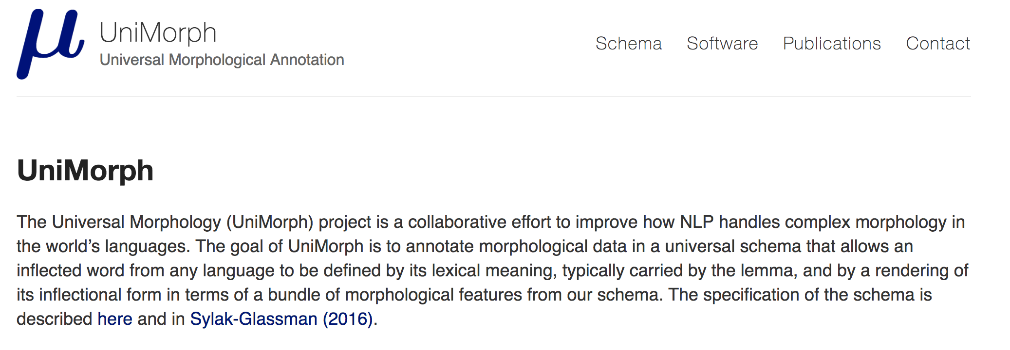
Plug For UniMorph
Now data for over 100 languages!
Freely downloadable from unimorph.github.io
Notes:
I am going to interrupt this talk for an unsolicited plug.

Slide 42
Estimating the Parameters
Estimating morphological irregularity is now a standard machine learning problem
Model is trained using gradient descent on UniMorph data
  Best model selected on development data
Irregularity = loss on held-out data

Slide 43
But why is there a trade-off?
This paper shows the existence of a trade-off between two types of morphological complexity
The real scientific question is why?
On-going work guesses that it has to learnability and the learning infrequent, irregular forms
  I.e., rare forms tend to regularize
Artificial learnability study already available
  Preliminary version on arXiv
Notes:
16:00

Slide 44
Linguistic Complexity More Broadly
Notes:
I’ve rambled on a lot about background material, as I am wont to do. So, what’s this paper actually about?

Slide 45
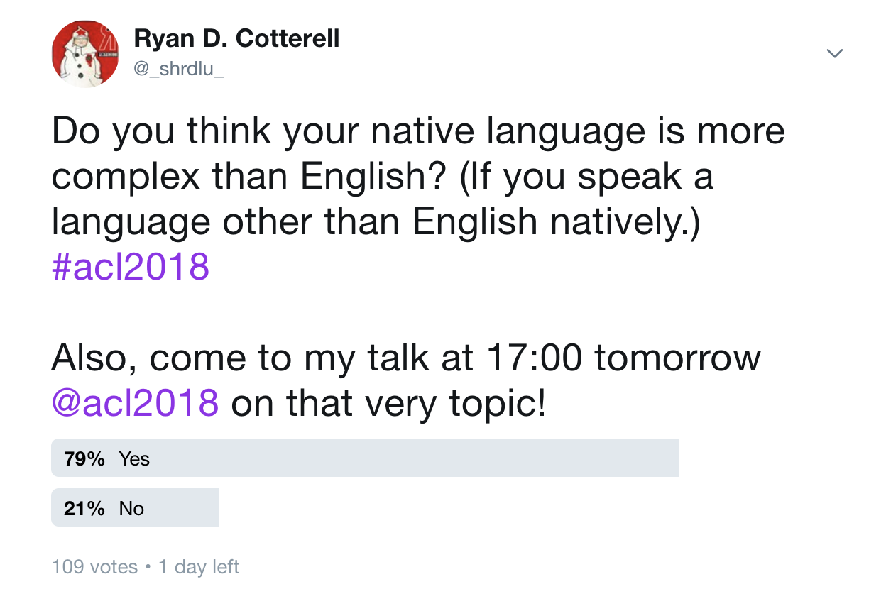
A Twitter Poll About Complexity

Slide 46
Equal Complexity Hypothesis
Hockett (1958) argued that all languages are equally complex
Idea goes back much further in the linguistics literature
All languages appear to optimize for efficient communication subject to learnability
Notes:
Jason does not like expressive.

Slide 47
Complexity Trade-Offs
Corollary: if one facet of a language is more complex, another is simpler to compensate
Trade-Off Example:
  German has more inflected forms than English (morphology)
  English has a more complicated tense system (syntax)
Notes:
Add Emoji
All a big balancing act

Slide 48
Example: Rate Of Speech (Pellegrino 2011)
Are all languages spoken equally fast?
  No!
Spoken Rapidly
  Spanish, Japanese
Spoken Slowly
  English, Chinese
Japanese
Syllabic Rate
Chinese
Information Density
Notes:
In general, tonal languages are among the languages spoken most slowly in the world
Constant rate of inforamtion

Slide 49
John McWhorter on Creoles
McWhorter wrote the seminal paper in 2001
Argues creoles are in fact less complex
Complexity accretes over time
  Creoles are new languages

Slide 50
Published Work
Check out our NAACL 2018 paper: All Are Languages Equally Hard to Language-Model?

Slide 51
Future Work
We only looked a specific trade-off in morphological complexity
  Data-driven methods for trade-offs in other areas of linguistics
Extensions look at language more holistically
  Trade-offs between morphology and phonology
  Trade-offs between morphology and syntax
Why didn’t linguistics already solve this problem?
  No big data, no methods
Notes:
"Why didn't linguists do this 10 years ago? Didn't have the datasets or a way consistent way to quantify irregularity. In general, the ACL community has a bunch of techniques that we can use to quantitatively investigate these interesting patterns in how the world's languages are distributed."

Slide 52
Fin

Slide 53
A Trade-Off in Morphological Complexity
Inflectional, morphological systems have a lot of forms, or a lot irregularity, but not both
No Languages Here
Irregularity
# Forms
Notes:
8:00

Slide 54
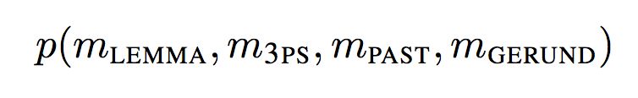
Morphological Knowledge as a Distribution
We assume morphological knowledge may be encoded as a probability distribution
Consider a distribution over the English forms
  run, runs, ran, running
Notes:
Jason thinks the the wording was contentious

Slide 55
Morphological Knowledge as a Distribution
close to unigram probability
close to zero
close to one
close to one
Notes:
NOTE only focus on conditional probabilities. Conditioned on the lemma.

Slide 56
Morphological Irregularity as Entropy
Let p be a distribution over forms in a paradigm.
Define irregularity as the entropy of that distribution
Entropy as irregularity due to Ackerman and Malouf (2013)
But, computing entropy is impossible
  We don’t know p
  Involves an infinite sum

Slide 57
Two-Step Recipe to Approximate H
Step 1: Bound entropy with cross-entropy
  holds for any q with the same support
Step 2: Empirically approximation cross-entropy
New Goal: Define a generative model of the paradigm
Notes:
H(p, q) \approx \sum_{i=1}^N \frac{1}{n} \log q(\tilde{m}^{(i)}_1, \ldots, \tilde{m}^{(i)}_n)

Slide 58
What a Can of Worms!
What actually makes a language complex?
Are some languages really more complex than others?
Notes:
ADD PICTURE OF WORMS

Slide 59
So, What’s This Paper Actually About?
Notes:
I’ve rambled on a lot about background material, as I am wont to do. So, what’s this paper actually about?

Slide 60
Trade-Offs within Morphological Complexity!
Notes:
I’ve rambled on a lot about background material. So, what’s this paper actually about? To sum it up in a phase, it’s about trade-offs in morphological complexity.

