Slide 1
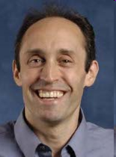

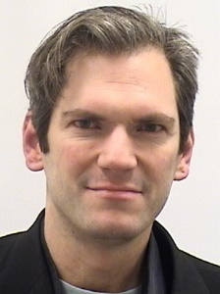



Gradually Learning to Read a Foreign Language:
Adaptive Partial Machine Translation
Jan. 2016
SOL Symposium
Jason Eisner
Chadia
Abras
Philipp
Koehn
Rebecca
Knowles
Adithya Rendu-chintala
with
1
Notes:
This isn’t what I usually work on.
You heard Alan Yuille’s talk this morning about structured models and deep learning for vision.
I do those things for language.
But Barbara and Kristin asked me to talk today about educational technology. This is a piece of work in progress that the SLI is kindly funding. And here are my collaborators.

Slide 2


Educational Technology
Main point of this talk
Notes:
Guy’s getting to run from a tiger.
His friend says, “What’s the point? You know we can’t outrun a tiger.”
He says, “I don’t have to. I just have to outrun YOU.”

Slide 3

Educational Technology
Main point of this talk
  To be useful in education, AI doesn’t have to be so smart.
  It just has to be smarter than you.
    At least, in the subject matter.
    That’s how it has something to teach you.
  It also has to know how to teach.
    Needs at least a crude idea of what your learning looks like.
    But it got smart itself via machine learning …
    … which might not be a terrible model of human learning.

Slide 4
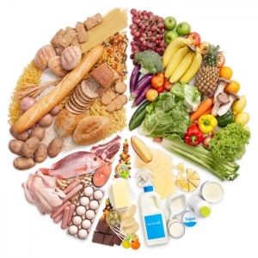
Educational Technology
“part of a well-balanced diet”
Can we design a good energy bar, using science?
Notes:
yum, here’s the chocolate down at the bottom

Slide 5
Educational Technology
Q: How are models of learners used now in education?
  Summative assessment – e.g., item response theory
  Formative assessment – e.g., Bayesian knowledge tracing
    Feedback during interactive homework
    Intelligent tutoring systems
    Educational games
  Fit a competence model of student’s current behavior

Slide 6
Educational Technology
Q: How are models of learners used now in education?
  Summative assessment – e.g., item response theory
  Formative assessment – e.g., Bayesian knowledge tracing
  Fit a competence model of student’s current behavior
New(?) goal: Construct new educational materials
  Not just selection from an existing item bank
  Individualized – interesting and useful to this student now
  Need a learning model to predict effect on student
    Construct stimuli that are predicted to achieve a desired effect
    If the actual effect doesn’t match, adjust learning model’s parameters
Notes:
We’re just getting to the point where we might be able to construct interesting new materials.
But we need a model of how the student changes. Then we can tweak our materials so that the predicted effect is good. If the actual effect is different, then we found out something useful about how particular student learns.

Slide 7
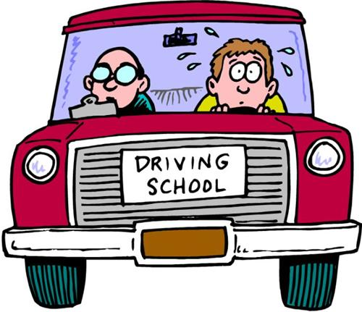
Immersion: Learning through Doing

Slide 8
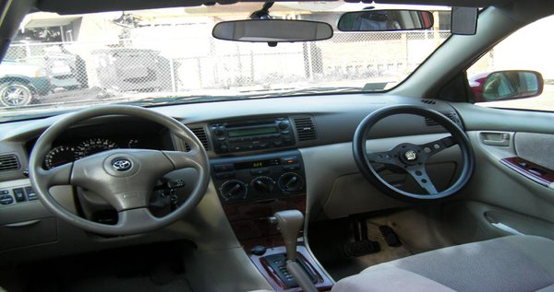
Immersion: Learning through Doing
Scaffolding: Provide enough support for student to succeed

Slide 9


Immersion: Learning through Doing
Foreign language comprehension
Kids learn language through exposure
So do L2 learners, eventually:
“It is widely agreed that much second language vocabulary learning occurs incidentally while the learner is engaged in extensive reading.” (Huckin & Coady, 1999)

Slide 10
Immersion: Learning through Doing
“Incidental learning” is powerful:
  You’re reading something that interests you.
  You learn how a word is really used in context.
  If you needed to engage with the new word to understand the text, you’ll retain it better.
  (“depth of processing” hypothesis, Craik et al. 1972)
  Builds coping strategies for using the language successfully outside the classroom.
  (Krashen 1989, Huckin & Coady 1999,
  Elgort & Warren 2014, etc.)
Notes:
learn usage

Slide 11
Immersion: Learning through Doing
“Incidental learning” is powerful
But not possible for adult beginners??
  To guess new words, you need to understand about 98% of the context (Nation 1990, Laufer 1997, etc.)
  So to read adult text, you need ~5000 words already
    And understand suffixes, sentence structure, etc.
    “Participants whose text comprehension
    was low were less likely to learn the
    meanings of the new vocab items …”
    (Elgot & Warren 2014)

Slide 12
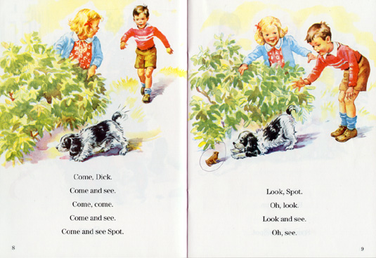
Immersion: Learning through Doing
“Incidental learning” is powerful
But not possible for adult beginners??
  To guess new words, you need to understand about 98% of the context (Nation 1990, Laufer 1997, etc.)
  So to read adult text, you need ~5000 words already
    “Larger gains were revealed for ... readers who reported higher interest and enjoyment…”
    (Elgort & Warren 2014)
Notes:
Who really cares about “see Spot run”?
This is also a tragedy in teaching adult L1 literacy

Slide 13
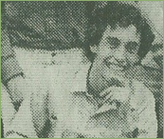

Back to 1985
Studying high school French
  Great deal of vocabulary
  Occasional exciting tidbits of grammar
  Little exposure to living language
    Trying to read a novel or newspaper was a painful exercise with a dictionary
Could I write a novel that gradually transitioned from English into French??
Notes:
Vocabulary learning was the big problem. The new bits of grammar and interesting general constructions didn't come nearly often enough. There were tenses we learned only in year 3 or 4. I really looked forward to the grammar parts. Ok, I'm a linguist, but I think it would have been easy to learn French grammar if we'd been allowed to use English words. It's learning to talk like Yoda -- kind of fun. Relation to inventive spelling.

Slide 14
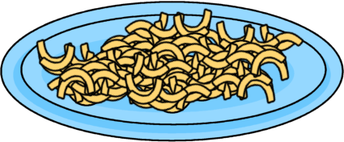
Macaronic Language
  What is this that roareth thus?
  Can it be a Motor Bus?
  Yes, the smell and hideous hum
  Indicat Motorem Bum!
  Implet in the Corn and High
  Terror me Motoris Bi:
  Bo Motori clamitabo
  Ne Motore caedar a Bo---
  Dative be or Ablative
  So thou only let us live:---
  Whither shall thy victims flee?
  Spare us, spare us, Motor Be!
  Thus I sang; and still anigh
  Came in hordes Motores Bi,
  Et complebat omne forum
  Copia Motorum Borum.
  How shall wretches live like us
  Cincti Bis Motoribus?
  Domine, defende nos
  Contra hos Motores Bos!

Slide 15
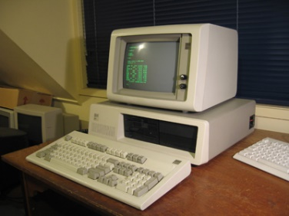
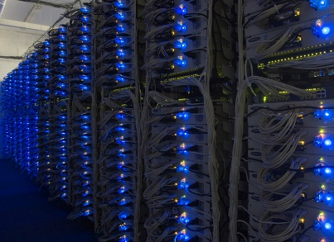

Computers Got Better Since 1985
?
Notes:
Well, computers got better.
And now that we can translate automatically from French to English,
could we do partial translation into macaroni, for purposes of learning?

Slide 16
A Spectrum of Macaronic Text
Slider interface
Why is this good?
  Constructivism – “meeting the student where he/she is”
  Meaningful reading experience
    Student can choose material (today’s news, romance, …)
  Can ask for hints by hovering over a word
    We showed them that word in French because we hoped they’d get it
    If they can almost guess or remember it, the hint will be timely
  Use hints and animation to show translation process
Notes:
Hint will seal the deal

Slide 17
The Macaronic Reading Interface
Reading interface

Slide 18

















A Spectrum of Macaronic Text
How do we do it?
First get a full translation, then interpolate at will

Slide 19


A Spectrum of Macaronic Text
How do we do it?
First get a full translation, then interpolate at will

Slide 20
A Spectrum of Macaronic Text
How do we do it?
First get a full translation, then interpolate at will

Slide 21
A Spectrum of Macaronic Text
How do we do it?
First get a full translation, then interpolate at will

Slide 22
A Spectrum of Macaronic Text
How do we do it?
First get a full translation, then interpolate at will
Notes:
The full translation could be either automatically or manually produced.
If manual, then this alignment is still automatically produced.
If automatic, then the alignment and other analysis is a byproduct of the automatic translation process.
If automatic, then make sure to start with real French text. It’s okay if the automatically translated English is wrong because it’s just scaffolding – they’ll understand it anyway and it won’t mislead them.

Slide 23
User Interface Trickiness
Idiomatic vs. literal translation
  Show intermediate steps?
  Should we use human translations when available, or are those too free?
Compound words
Word endings (tense, agreement, etc.)
Orthographic conventions (contraction, caps, …)
Right-to-left languages
Transliteration

Slide 24
User Interface Trickiness
Nous aurons besoin des gateaux
Notes:
“We will need the cakes”

Slide 25

User Interface Trickiness
Nous aurons besoin des gateaux
We
Notes:
“We will need the cakes”

Slide 26
User Interface Trickiness
Nous avoir-ons besoin des gateaux
Notes:
“We will need the cakes”

Slide 27
User Interface Trickiness
Nous avoir-ons besoin des gateaux
have
Notes:
“We will need the cakes”

Slide 28
User Interface Trickiness
avoir
Nous have-erons besoin des gateaux
Notes:
Part of a larger phrase, so could translate that phrase

Slide 29
User Interface Trickiness
Nous have-erons besoin des gateaux
Notes:
Part of a larger phrase, so could translate that phrase

Slide 30
User Interface Trickiness
avoir
Nous have-erons besoin de-les gateaux
need
of
Notes:
And that phrase has a more idiomatic translation

Slide 31
User Interface Trickiness
avoir
besoin de
Nous have-erons need of les gateaux
Notes:
“We will need the cakes”

Slide 32
User Interface Trickiness
Nous have-erons need of les gateaux
Notes:
“We will need the cakes”

Slide 33
User Interface Trickiness
avoir
besoin de
Nous have-erons need of les gateaux
need
Notes:
“We will need the cakes”

Slide 34
User Interface Trickiness
have need of
Nous need-erons les gateaux
Notes:
“We will need the cakes”

Slide 35
User Interface Trickiness
Nous need-erons les gateaux
FUTURE
Notes:
“We will need the cakes”

Slide 36
User Interface Trickiness
-erons
Nous will need les gateaux
Notes:
“We will need the cakes”

Slide 37
User Interface Trickiness
Nous will need les gateaux
the
Notes:
“We will need the cakes”

Slide 38
User Interface Trickiness
Nous will need les gateau-x
Notes:
“We will need the cakes”

Slide 39
User Interface Trickiness
Nous will need les gateau-x
PLURAL
Notes:
“We will need the cakes”

Slide 40
User Interface Trickiness
-x
Nous will need les gateau-s
Notes:
“We will need the cakes”

Slide 41
User Interface Trickiness
-x
Nous will need les gateau-s
cake
Notes:
“We will need the cakes”

Slide 42
User Interface Trickiness
gateaux
Nous will need les cakes
Notes:
Could also pop up grammar tips

Slide 43
User Interface Trickiness
have need of
Nous will need les cakes
Notes:
Could also pop up grammar tips

Slide 44
User Interface Trickiness
Nous will have need of les cakes
need
Notes:
Could also pop up grammar tips

Slide 45
User Interface Trickiness
Nous will have need of cakes
Notes:
Could also pop up grammar tips

Slide 46
User Interface Trickiness
avoir
Nous will have need of cakes
Notes:
Could also pop up grammar tips

Slide 47
Two Kinds of Machine Learning
Replicate human intelligence (traditional AI)
Augment human intelligence (big data)

Slide 48
How to Build AI?
Replicate human intelligence (traditional AI)
  Old way: Build an adult
    Write down everything an adult knows (expert systems)
  New way: Build a learner
    Exposed to examples of correct behavior (learn to mimic)
    Or merely rewarded for “good” behavior (learn to plan)
    These cognitive models of learners might also
    have a use in teaching!
Notes:
Now, is this trying to be an accurate model of a human learner? Well, ML people like to make their models work as well as possible, so it's tempting to put adult knowledge into them. If we put some background knowledge into the learner, it might learn faster. But even real learners probably have some background knowledge built-in for this reason: in evolutionary theory, that's called the Baldwin effect. For instance, in human language, babies might expect to see adjectives and nouns and expect that they would be next to each other. But of course they don't know that adjectives come before nouns, since that's specific to English. And they don't know that the noun for this is pronounced "ear." So we can't build that into our artificial systems either, if we want them to be able to learn multiple languages and not just speak English.

Slide 49
Cognitive Models in Educational Software
Calibration – what does student know now?
Constructing materials – what would student learn from?
Planning – what should we teach first?
Notes:
1. CALIBRATION. Figure out what a particular learner currently knows. Not just for grading, but for deciding what to show them next. Of course, there's already Item Response Theory in statistics, which tries to design tests and interpret their results. But in ML, we often go to war with the data we have. If we're taking the student through an activity where they have to use their skills in a meaningful way, we can observe what they're doing, and try to guess from that what they know. 2. CONSTRUCTING MATERIALS. If our system is going to teach the student, it needs to know more about the subject than the student. For arithmetic, that's easy. But how about for skills like reading a foreign language, where the knowledge isn't easy to write down? Our AI systems aren't as good as native speakers, but they might be better than beginners. And sometimes that might be enough to teach the beginners. 3. PLANNING. Based on what the learner knows, what should we show them next? Our model will predict the results. Sometimes the results might be cumulative, so we need to plan ahead. We also need to plan if we're doing offline learning.

Slide 50

Two Learners In This Picture
Notes:
Student, and machine, which needs a model of the student

Slide 51
System’s Model of the L2 Student
What would happen if the student read a given macaronic sentence?
Would they understand it?
What would they take away from it that would affect their understanding of future sentences?
What should we do about that?

Slide 52


Planning and Learning
UI
best plan
Planner
test plan
Model of how student learns
Model of student’s
competence
Curriculum planning
But model of an idealized student
may not match real students
Real students don’t even
match one another
Notes:
First you test a plan – e.g., the student wants to read The Magic Mountain, so how will you macaronize that novel?
To test a plan against the model, you ask what would happen if you ran it.
You might test many plans, and maybe there’s a clever way to search that exponentially large space, but you don’t have to be perfect.
Pick whichever plan results in the most predicted learning.
How do you quantify that? E.g.,

Slide 53
Planning and Learning
UI
Planner
Personalized learning
Requires a parametric
model of learners, which
we calibrate by feedback
Planner may do exploration
(e.g, testing)
Model of how student learns
Model of student’s
competence

Slide 54
MT System as a Model of Learning
Model student as a kind of MT system.
Translating Macaronic German to English is a simplification of translating German to English.
In both cases, machine needs to use context.
But in the macaronic case, some of the work has already been done (yay).

Slide 55

Simple Case: Guess one word
Those who received high Lohn later receive high pensions.
But that was more than 30 Jahre ago.
Context + spelling + previous exposure
Notes:
What goes in the blank? salaries or wages, not “loans”. You would need rather deep understanding of economics to guess this. Our model wouldn’t expect you to guess it.
How about second one? Well, if you already know that “J” is pronounced as “y”, then you can combine the sound of the word with the context to guess that “Jahre” is year, or more likely “years.”
And of course, maybe you know more than just that “J” is “y” – you might already know the word “Jahre.”

Slide 56
Competence Model of Student
Model of how student learns
Model of student’s
competence
Context + previous exposure + spelling
Cue combination, perhaps merely by Naive Bayes:
  What English words would fit in this German word’s context?
  Have I seen this German word before, and how did I translate it then?
  Have I seen any of these German sounds/subwords before?
Hill-climbing to deal with uncertainty:
  Translating one word provides more context for others
Notes:
So what does this COMPETENCE MODEL of the student look like? Well, for every English word or phrase, they have some guesses about how to say it in French, or vice-versa. They know this because they've learned some French vocabulary, as well as some standard changes between French and English that allow them to guess about new words -- "absolument" might mean "absolutely," since it has the same root and a common French adverbial suffix. They also know something about how the word order changes, and what would be reasonable things to say in the first place, which is how they can fill in the blank. This kind of competence model doesn't *really* understand the sentence - and we can't make it smarter with current technology. On the other hand, it is improbably patient and it has good reading strategies; maybe we can dumb it down by using a simple search strategy strategy. Maybe just Naive Bayes. Left context, right context, cognate model, and memorized vocabulary. Try to translate sentence stepwise using hill-climbing, and each translation improves context for subsequent translations.

Slide 57
Learning Model of Student
Model of how student learns
Model of student’s
competence
How does competence model change with exposure to macaronic text?
Training data for standard MT learner:
  Une stratégie républicaine pour contrer la réélection d'Obama
  a Republican strategy to counter the re-election of Obama
Training data for our macaronic learner:
  a Republican strategy pour contrer the re-election d'Obama
  Guess what this means in English, using competence model
  Update competence model to predict that answer better (self-training)

Slide 58
Learning Model of Student
Training data for our macaronic learner:
  a Republican strategy pour contrer the re-election d'Obama
  Guess what this means in English, using competence model
  Update competence model to predict that answer better (self-training)
Why might real learners diverge from this idealized model?
  And from one another?
Two natural answers:
  Learning doesn’t always succeed – updates are sometimes zero or small.
  Forgetting – parameters sometimes revert to prior values.
  So, model per learner when this tends to happen.
  Certain types of parameters learn / forget at different rates?
  How sure do you have to be that you understood before you’ll update?
  How hard do you try to understand in the first place?
Notes:
[Forgetting] In particular, the trigger “Jahre” →“years” might start to weaken.
But that’s not as bad as weakening the trigger “Lohr” → “wages”, because in the case of “Jahre,” you have redundant cues to get it back, from the sound of the word. So next time you see “Jahre,” you might still be able to understand it, which will remind you to re-learn it. And this is in keeping with human studies.

Slide 59
Simple Case: Guess one word
Sentences from www.nachrichtenleicht.de
(news site in “simple German”)
MTurkers are asked to guess the English word
  Given the German word or its English context or both
  No German experience - find out what beginners can do
    Can we model these human guesses?
    If so, we can use that as the initial state of our competence model

Slide 60
Harder Task: Interpret German sentence
MTurkers are asked to translate a German sentence
  They are allowed to peek first at some words – but not all
What words do they think they understand?
  And are they right: do they actually understand them?
Which words are most helpful in guessing which other words?
Again, fit a competence model that we can start with.
And perhaps a learning model: do our subjects improve?

Slide 61
Possible Extensions to the System
Intersperse quizzes with macaronic reading
  Provides an incentive to the student
  Gathers cleaner info about student’s current competence
Demand macaronic writing too
  Ask student to write freely, macaronically if needed
    Similar to “inventive spelling” for young children
    Provides incentive to recall foreign words, learn gender, etc.
  Suggest modest edits to make text more foreign
Speaking and listening
  Others have worked on this; integrate with macaroni

Slide 62
Educational Technology
Main point of this talk
  To be useful in education, AI doesn’t have to be so smart.
  It just has to be smarter than you.
    At least, in the subject matter.
    That’s how it has something to teach you.
  It also has to know how to teach.
    Needs at least a crude idea of what your learning looks like.
    But it got smart itself via machine learning …
    … which might not be a terrible model of human learning.
Jason
Eisner
Philipp
Koehn
Chadia
Abras
Rebecca
Knowles
Adithya Renduchintala

