Slide 1
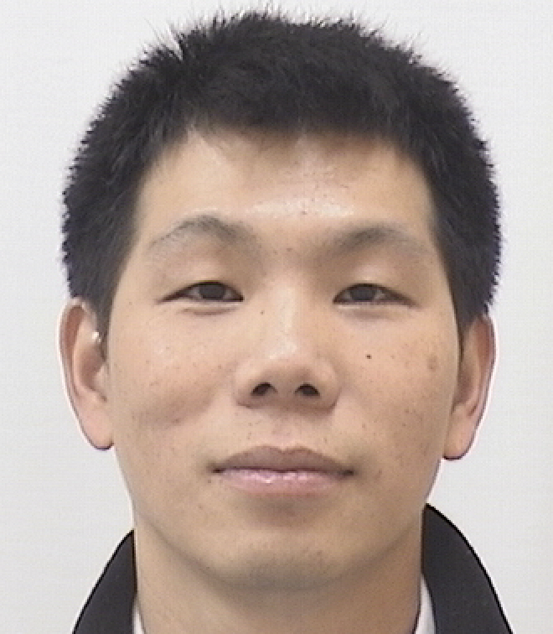

Hyperparameter Optimization for Low-Resource Machine Translation
Kevin Duh and Xuan Zhang
Johns Hopkins University
Notes:
Hello. My name is Kevin Duh and I’ll be talking about the challenge of optimizing neural network hyperparameters for multiple objectives, and the importance of building benchmarks for this problem.

Slide 2
It’s important to tune hyperparameters!
Histogram of BLEU scores for 700+ Swahili-English Neural Machine Translation models: same training data, different hyperparameters
better translation
Notes:
Let’s start with an example to illustrate the importance of hyperparameters. Here, I’ve trained about 700 different transformer models for the task of machine translation. The different hyperparameters include number of layers, size of word embeddings, and learning rate. In this histogram which plots translation accuracy in terms of BLEU score, you see a large variance. Many models actually have low BLEU scores; we need to try a lot of hyperparameters to get the best model on the right here.

Slide 3
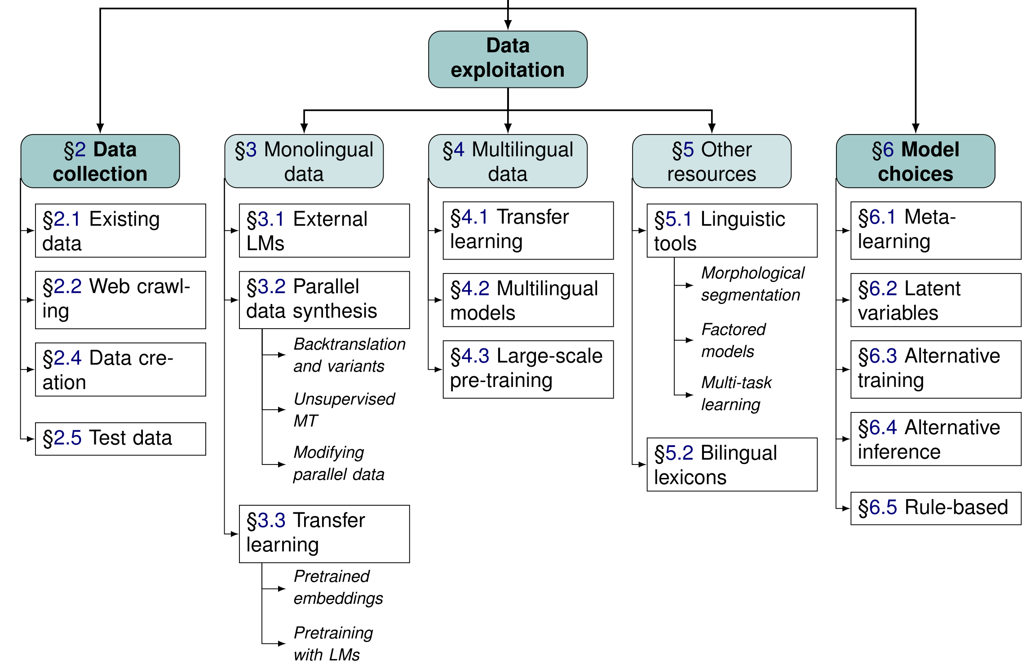
A taxonomy of methods for low-resource MT
Hyperparameter
Optimization
Figure from:
Barry Haddow, Rachel Bawden, Antonio Valerio Miceli Barone, Jindřich Helcl, and Alexandra Birch. 2022.
Survey of Low-Resource Machine Translation. Computational Linguistics, 48(3):673–732.

Slide 4
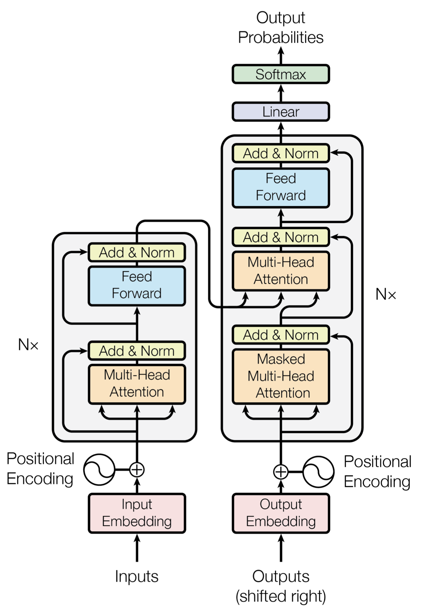
Hyperparameters
Hyperparameters = Configurations of a model that are not updated in training
Architectural hyperparameters:
  # of layers
  # of hidden units in feed-forward layer
  # attention heads
  Word embedding dimension
Training pipeline hyperparameters:
  # of subword units
Optimizer hyperparameters:
  Initial learning rate for ADAM, etc.

Slide 5
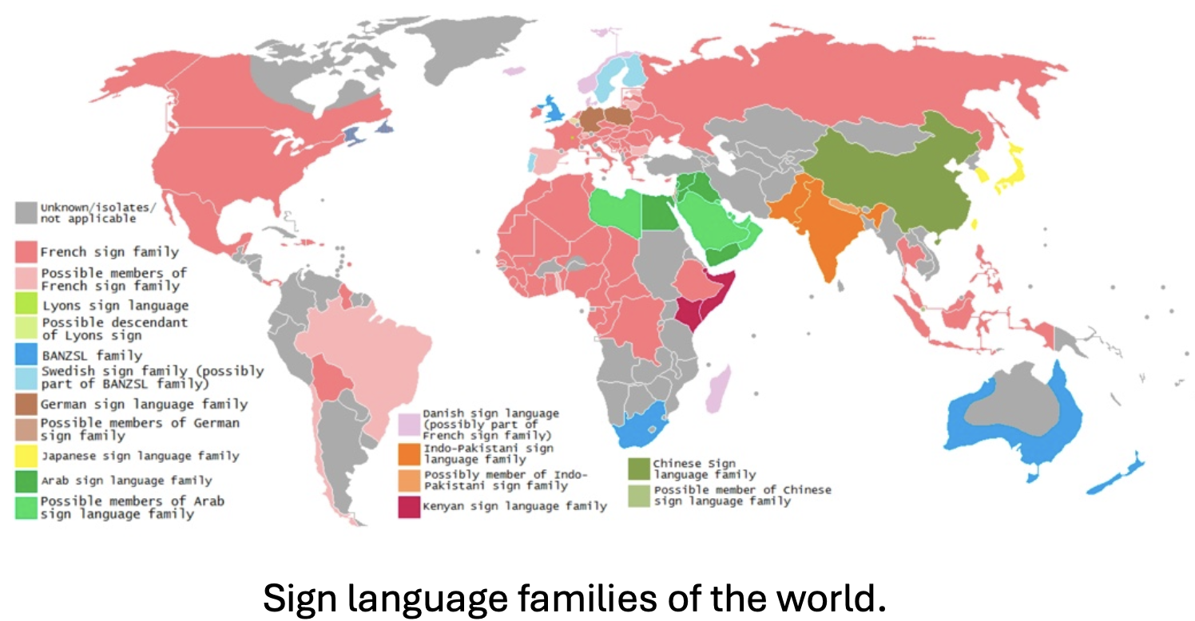
Example Low-Resource Problem:
Sign Language Translation
200+ Sign Languages
In USA, 9 million people (3% of population) reports using American Sign Language (ASL)
But very few resources

Slide 6
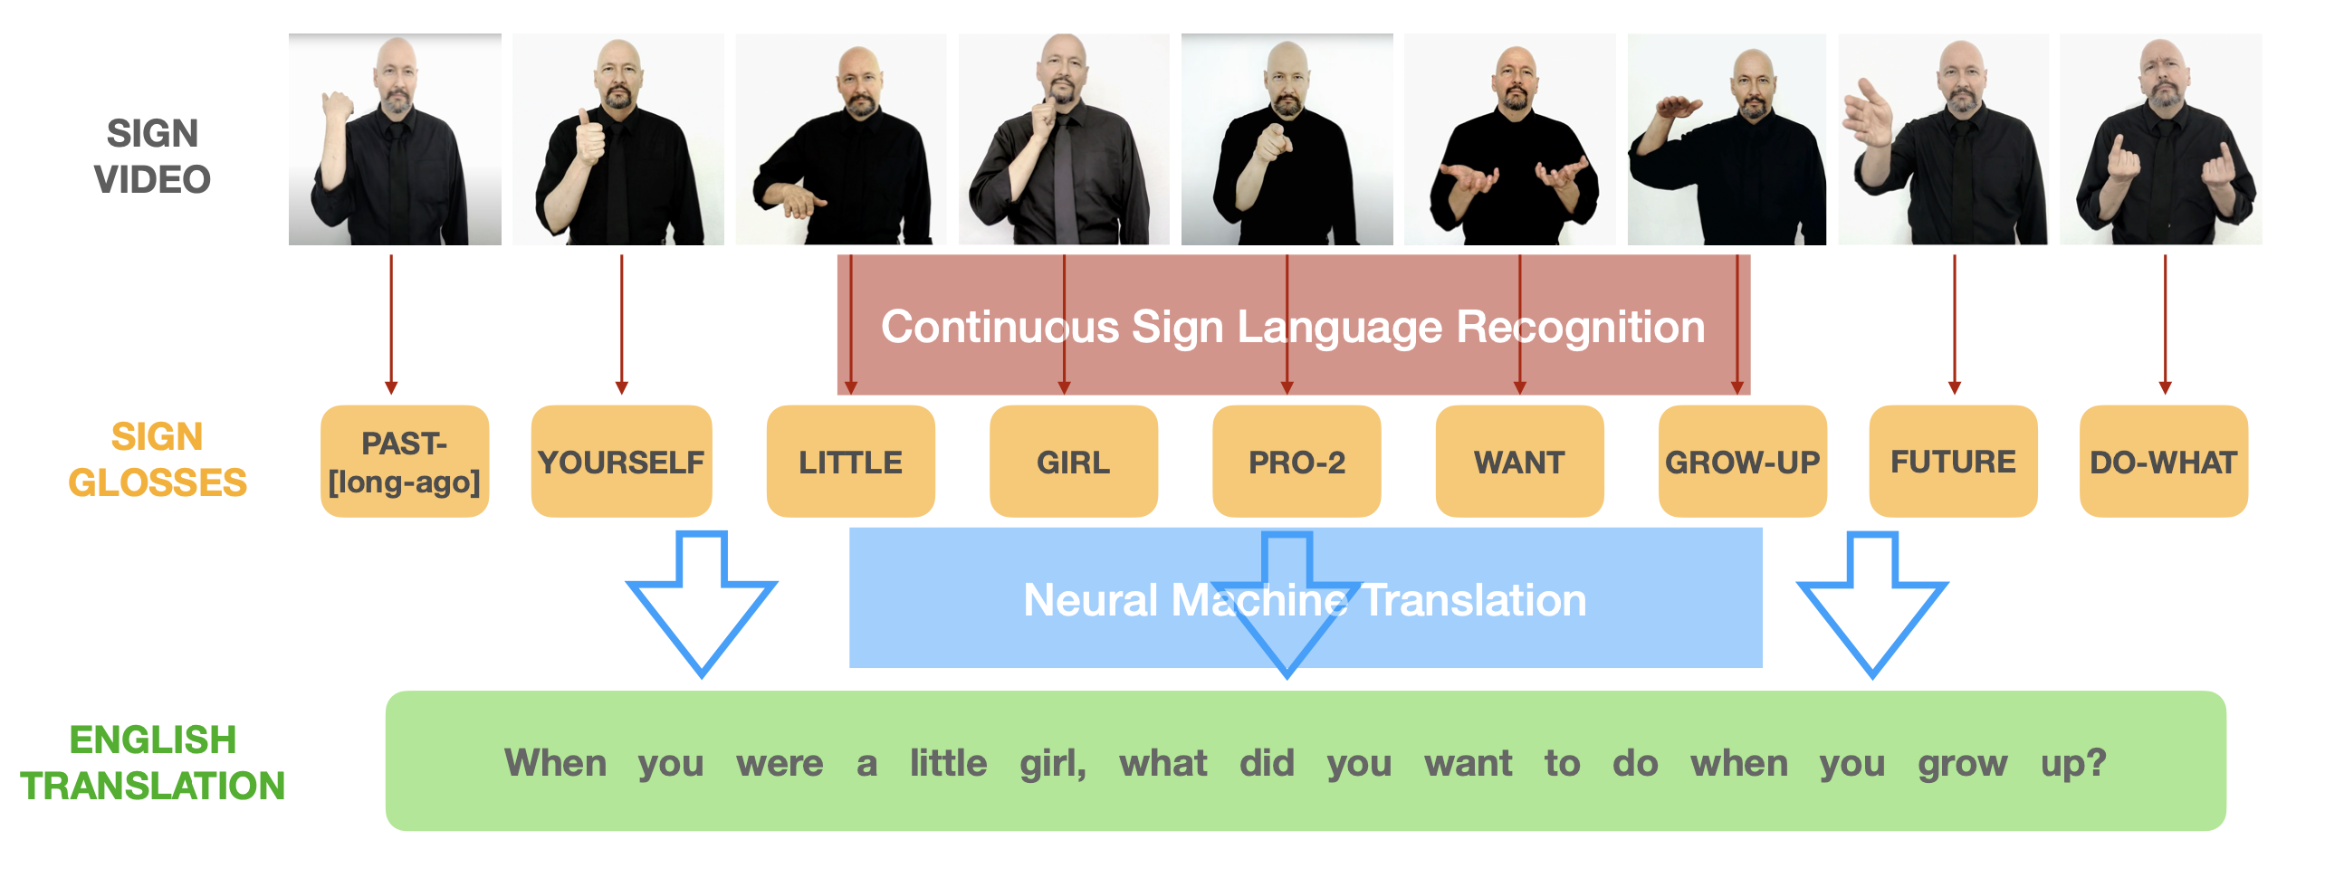
Example Low-Resource Problem:
Sign Language Translation
Cascaded approach:
Limited training data, e.g.,
How2Sign has 35k lines, 79 hours (American Sign Language to English)
Phoenix2014T has 7k lines, 11 hours (German Sign Language to German)

Slide 7
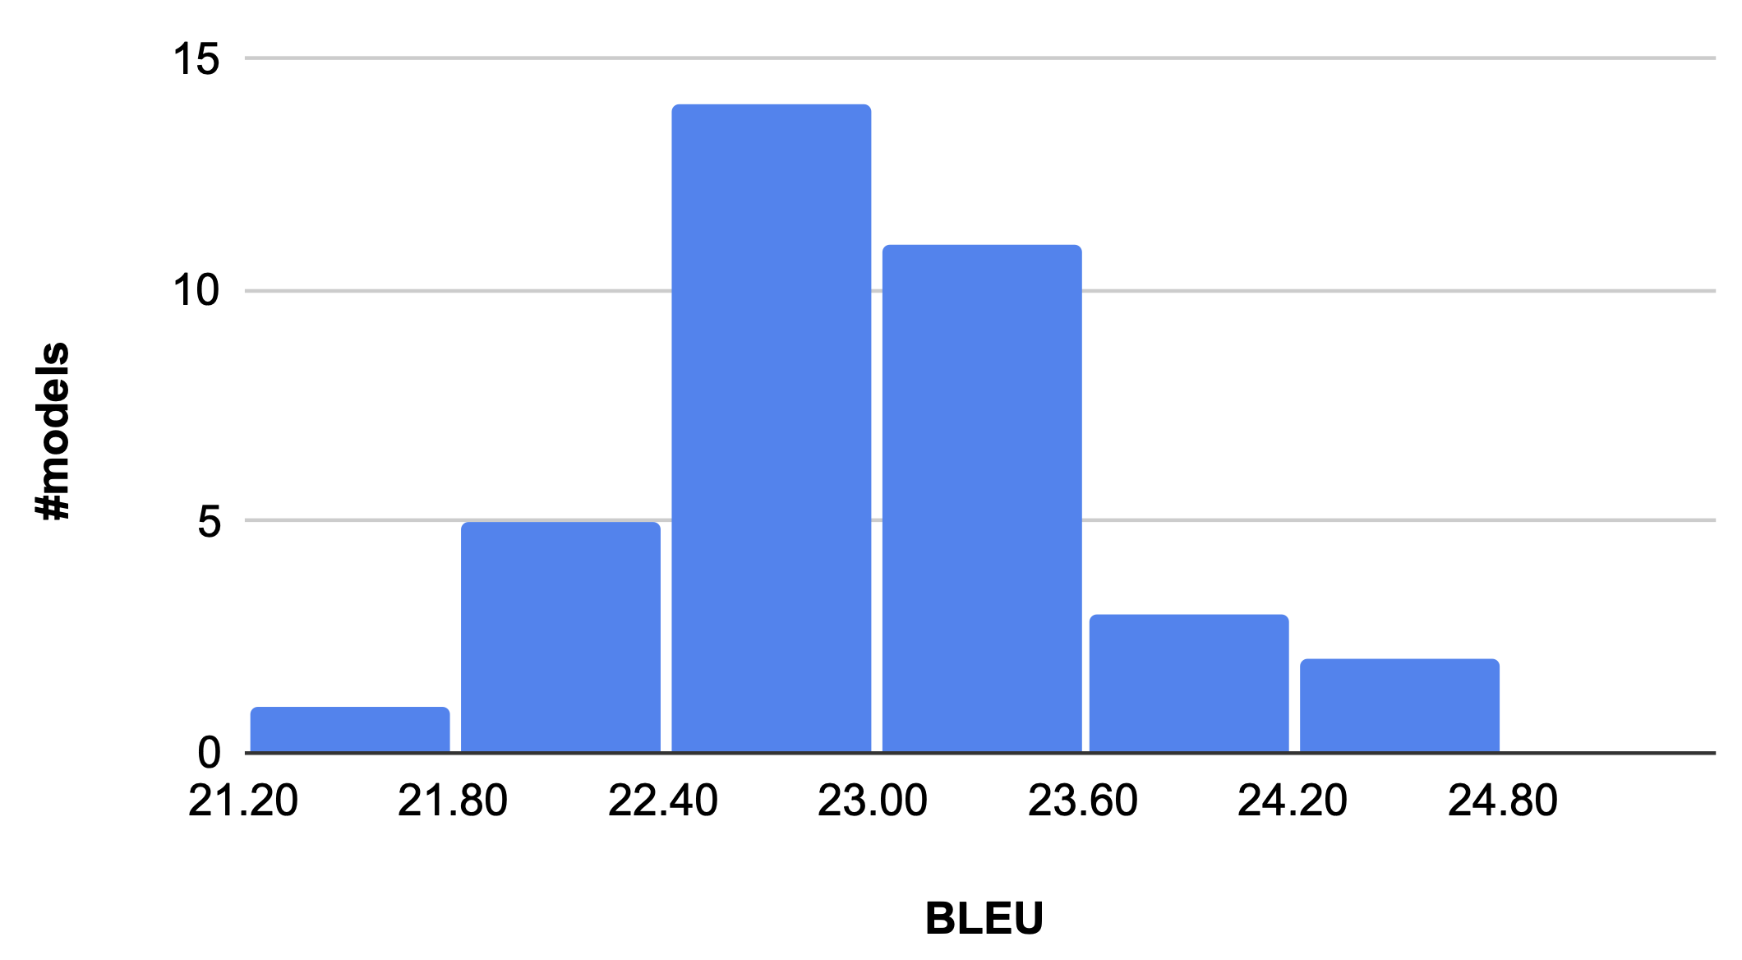
BLEU differences due to hyperparameters
Histogram of BLEU scores for 36 Gloss-to-Text Transformer models (different hyperparameters) on Phoenix14T

Slide 8
Can you predict which hyperparameter setting leads to high BLEU?
I cannot!
System 1:
BPE=1k, #Layer=4, #Embed=512, InitLR=.00005
System 2:
BPE=2k, #Layer=1, #Embed=512, InitLR=.0005
System 3:
BPE=1k, #Layer=2, #Embed=256, InitLR=.0002

Slide 9
Can you predict which hyperparameter setting leads to high BLEU?
System 1:
BPE=1k, #Layer=4, #Embed=512, InitLR=.00005
System 2:
BPE=2k, #Layer=1, #Embed=512, InitLR=.0005
System 3:
BPE=1k, #Layer=2, #Embed=256, InitLR=.0002

Slide 10
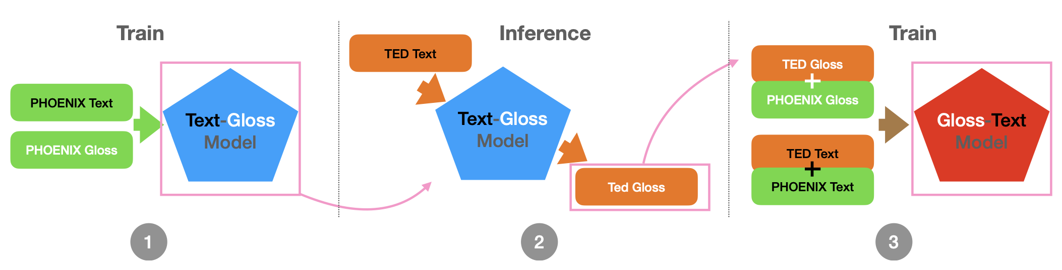
Hyperparameter Search Space
In some cases, grid search is possible
  BPE: {1k, 2k}, #Layer: {1, 2, 4}, #Embed:{256, 512}, InitLR: {.00005, .0002, .0005}
  2 x 3 x 2 x 3 = 36 configurations
Else, we recommend automatic hyperparameter optimization (HPO)!
  Train a model with a larger hyperparameter space
  Train an entire pipeline of models, e.g., backtranslation

Slide 11
Emerging HPO & AutoML research
Automated Machine Learning (AutoML) is a newly recognized field within machine learning. Conference topics include:
  Hyperparameter Optimization (HPO)
  Neural Architecture Search (NAS)
  Algorithm Selection
  Systems for Machine Learning (SysML)
We should adapt these tools for low-resource MT!

Slide 12
Outline
Motivation
Problem Definition & Representative Hyperparameter Optimization (HPO) Methods
HPO Benchmark for Machine Translation
Beyond black-box HPO

Slide 13
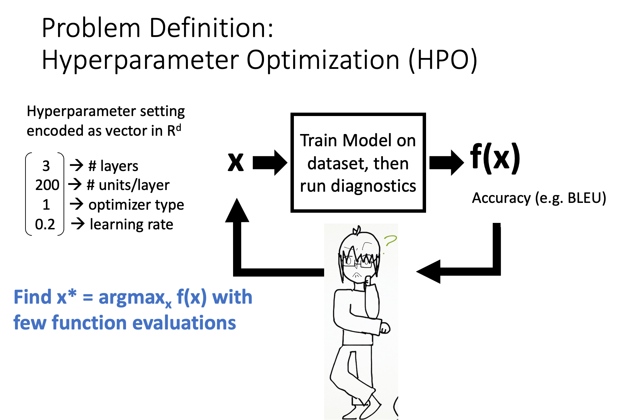
*Clipart by Lea Duh

Slide 14

Problem Definition:
Hyperparameter Optimization (HPO)
f(.)
Hyperparameter setting
encoded as vector in R^{d}
Train Model on dataset, then run diagnostics
x
y=f(x)
3 → # layers
200 → # units/layer
1 → optimizer type
0.2 → learning rate
Accuracy (e.g. BLEU)
Find x* = argmax_{x} f(x) with few function evaluations

Slide 15








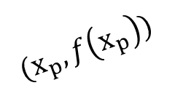


Bayesian Optimization
Expected Improvement
sample
$$x_{1}$$
$$x_{2}$$
$$x_{p}$$
$$x_{3}$$
$$x_{i}$$
evaluate
$$f\left(x\right)$$
$$(x_{1},\hat{f}\left(x_{1}\right))$$
Guassian Process
$$(x_{2},\hat{f}\left(x_{2}\right))$$
$$(x_{3},\hat{f}\left(x_{3}\right))$$
$$(x_{p},f\left(x_{p}\right))$$
fit
$$(x_{i},\hat{f}\left(x_{i}\right))$$

Slide 16
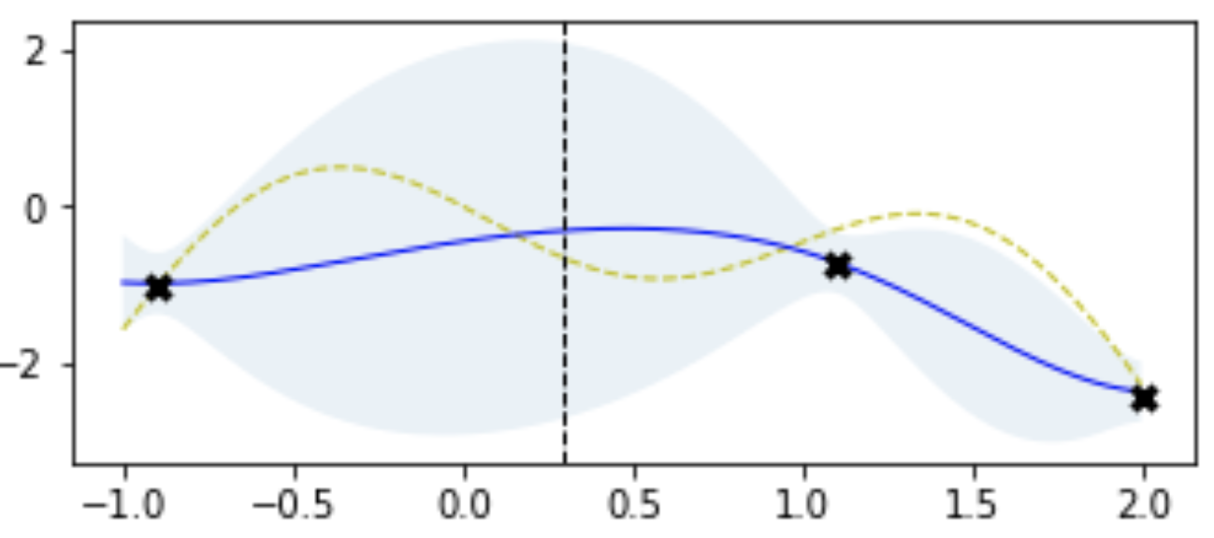
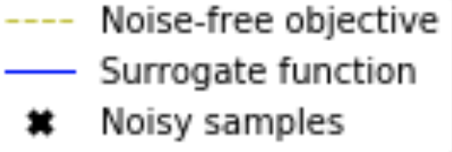
Gaussian Process Regression
Fit Gaussian Process regression on these samples
Low variance for predictions nearby. High variance for prediction far away
f(x) objective function
Gaussian Process Prediction
Samples
y-axis: f(x)
x-axis: value of one hyperparameter
Models that have already been sampled, observed x & f(x) pairs
From: Martin Krasser. http://krasserm.github.io/2018/03/21/bayesian-optimization/

Slide 17
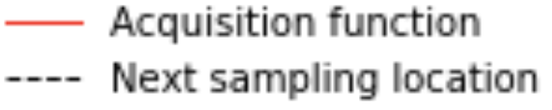
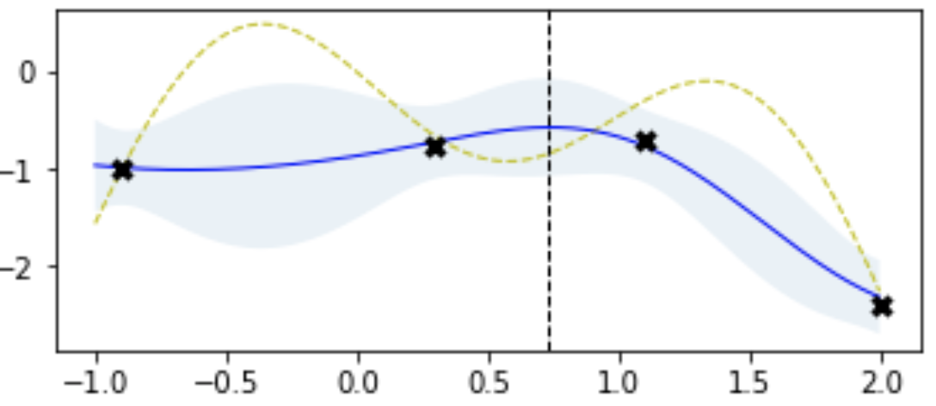
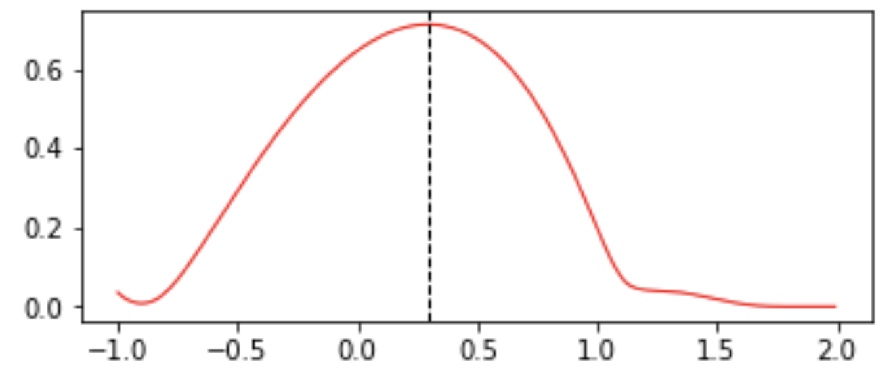
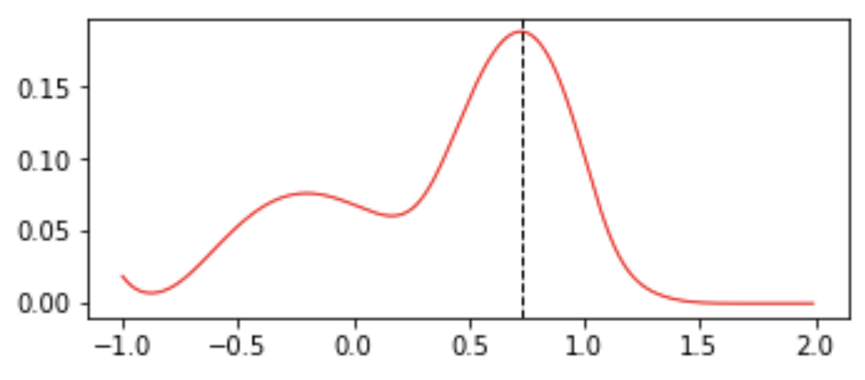
Bayesian Optimization
f(x) objective function
Gaussian Process Prediction
Samples
Expected Improvement
Next Sampling Location
Iteration 1
Iteration 2
Expected
Improvement
From: Martin Krasser. http://krasserm.github.io/2018/03/21/bayesian-optimization/

Slide 18
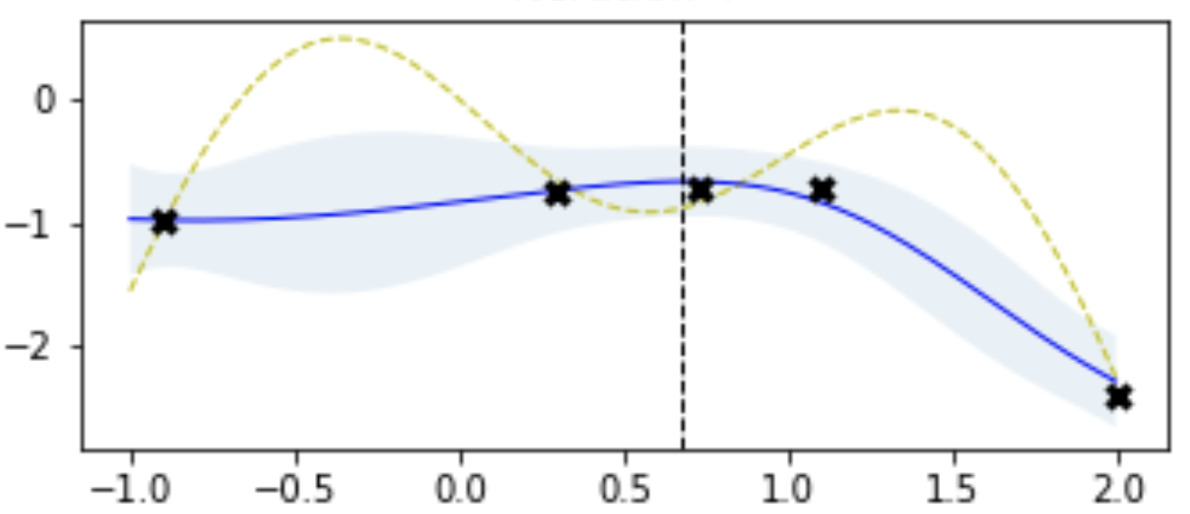
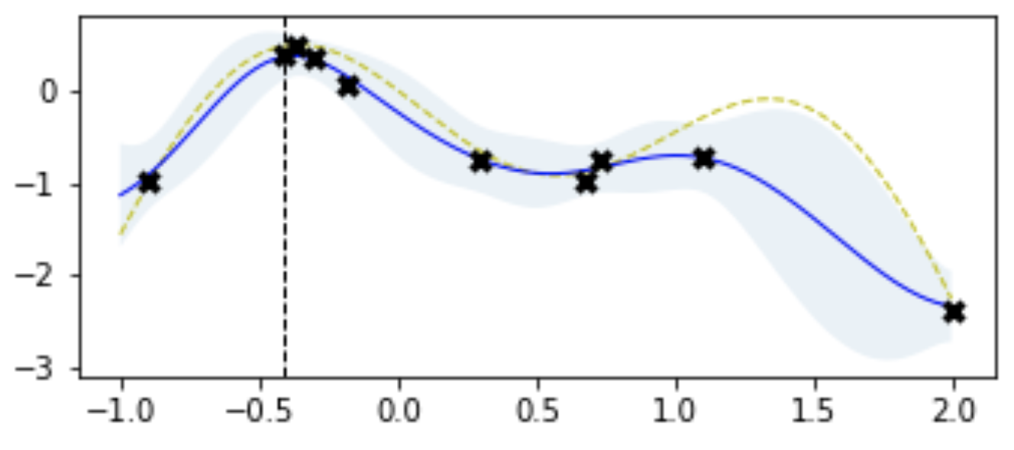
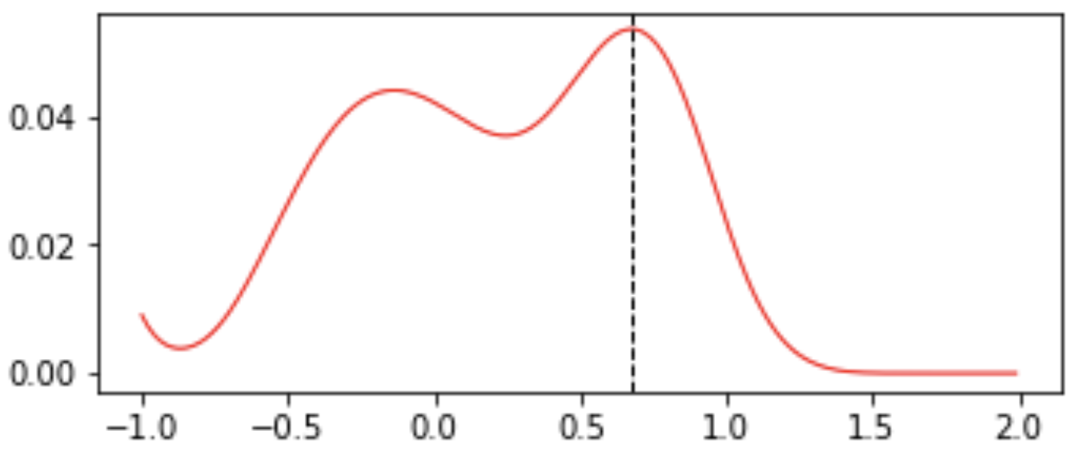
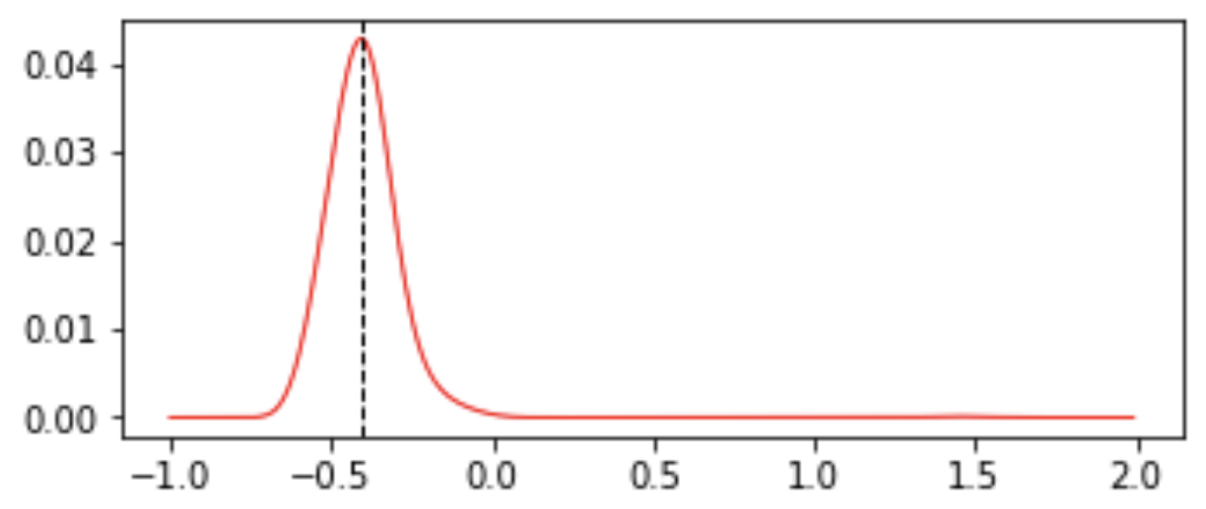
Bayesian Optimization
f(x) objective function
Gaussian Process Prediction
Samples
Expected Improvement
Next Sampling Location
Iteration 2
Iteration 3
Iteration 8
Expected
Improvement
From: Martin Krasser. http://krasserm.github.io/2018/03/21/bayesian-optimization/

Slide 19
Covariance Matrix Adaptation
Evolutionary Strategy (CMA-ES)
Search Distribution
Sample
Normal Distribution:
mean
covariance
Iterate
Update
distribution
評価結果
評価結果
評価結果
評価結果
Evaluate f(x)
N. Hansen, S. D. Muller, and P. Koumoutsakos, “Reducing the time complexity of the derandomized evolution strategy with covariance matrix adaptation (CMA-ES),” Evolutionary Computation, vol. 11, no. 1, pp. 1–18, 2003.

Slide 20
Evolutionary Strategy for HPO
Start with a population of “individuals”, each representing a hyperparameter setting
The “fittest” ones (high f(x)) survive and produce offspring
Generation 0

Slide 21
Evolutionary Strategy for HPO
Start with a population of “individuals”, each representing a hyperparameter setting
The “fittest” ones (high f(x)) survive and produce offspring
Generation 1

Slide 22
Evolutionary Strategy for HPO
Start with a population of “individuals”, each representing a hyperparameter setting
The “fittest” ones (high f(x)) survive and produce offspring
Generation 2

Slide 23
Estimating the search distribution
Vector from previous mean to x_{k}
Mean update:
Mean of
previous generation
Weight for individual (x_{k}, y_{k}=f(x_{k})),
Better Pareto rank → higher weight

Slide 24

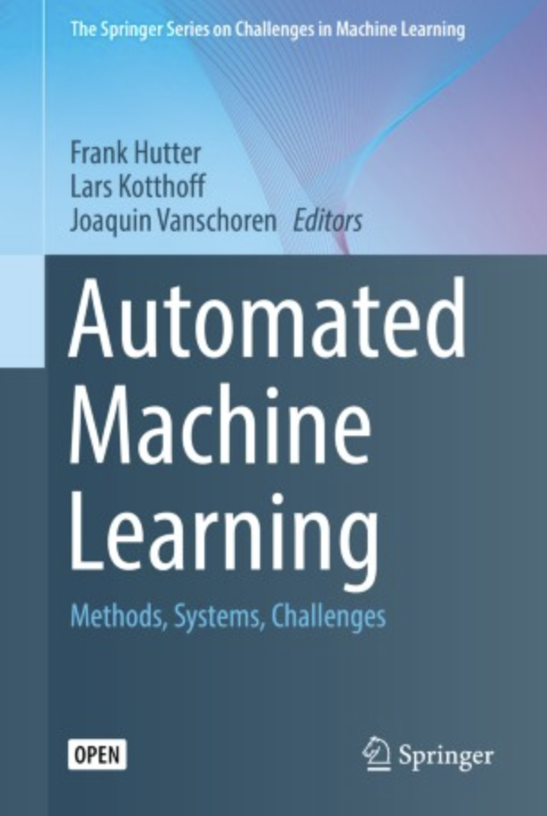
To learn more, check out our EACL’23 Tutorial:
https://www.cs.jhu.edu/~kevinduh/a/automl-tutorial-2023/
A good reference:
A Taxonomy of Algorithms
Black-box optimization
Brute-Force
e.g. Random search, Grid search
Learn from previous function evaluations f(x_{k})
Gradient-based optimization
e.g. many NAS methods
Estimate search distribution
e.g. Evolutionary strategy, Genetic algorithms
Estimate f(x) directly
e.g. Bayesian optimization, Random Forests
Cross-cutting techniques:
e.g. Hyperband, BOHB

Slide 25
Outline
Motivation
Problem Definition & Representative Hyperparameter Optimization (HPO) Methods
HPO Benchmark for Machine Translation
Beyond black-box HPO

Slide 26
Evaluation in this field is extremely hard!
Evaluation is hard due to computational constraint:
  Suppose it takes 1 week to train one model
  Each HPO algorithm samples and trains 100 models at best
Cannot do head-to-head comparison, repeated trials → don’t know if an algorithm really works!
Li & Talwalkar (2019) Random search & Reproducibility for Neural Architecture Search: “Of the 12 papers published since 2018 at NeurIPS, ICML, and ICLR that introduce novel NAS methods, none are exactly reproducible.”
  Also: Lindauer & Hutter. Best Practices for Scientific Research on Neural Architecture Search, JMLR 2021. https://www.jmlr.org/papers/volume21/20-056/20-056.pdf

Slide 27
(Crazy) Solution: Tabular Benchmarks
One-time fixed cost:
  Run grid search, training MANY models on some dataset
  Publish all {x,f(x)} pairs in a table
HPO algorithm developers:
  Experiment with HPO on finite universe
  Can run repeated trials quickly
Table
Look-up
x
f(x)
Accuracy

Slide 28
Our NMT Tabular Benchmark (version 1)
Total: 2245 Transformer models, trained on ~1550 GPU days; record BLEU, train/test time, etc.
https://github.com/Este1le/hpo_nmt
Hyperparameter Type | Possible Values
# BPE Subword Units | 1k, 2k, 4k, 8k, 16k, 32k, 50k
# Transformer Layers | 1, 2, 4, 6
Word embedding | 256, 512, 1024
# Hidden Units | 1024, 2048
# Attention Heads | 8, 16
Initial Learning Rate for ADAM | 3x10⁻⁴, 6x10⁻⁴, 10x10⁻⁴
Dataset | Domain | #models
zh-en | TED | 118
ru-en | TED | 176
ja-en | WMT | 150
en-ja | WMT | 168
sw-en | MATERIAL | 767
so-en | MATERIAL | 605

Slide 29
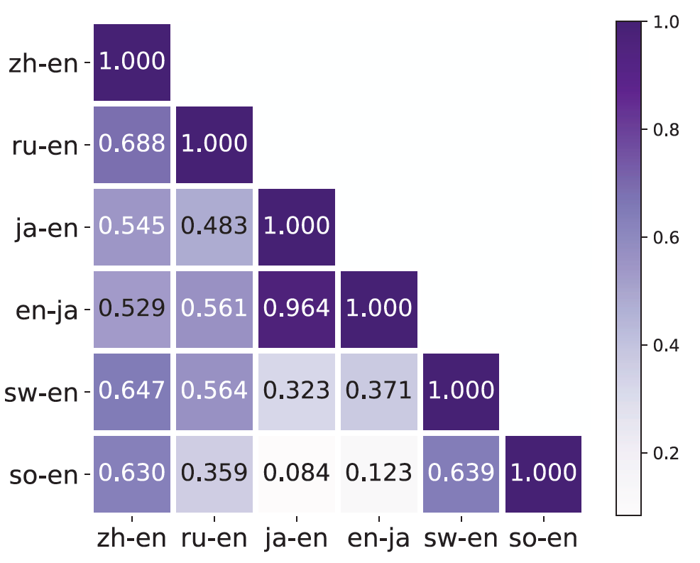
Diversity in dataset
Low Spearman’s correlation when comparing hyperparameter rankings across datasets

Slide 30
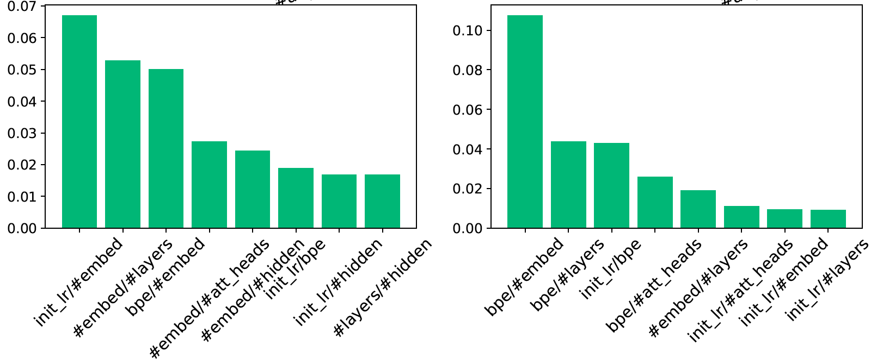
Diversity in dataset:
Hyperparameter importance by fANOVA, measuring BLEU variance when changing a specific hyperparameter value pairs
en-ja dataset
sw-en dataset

Slide 31
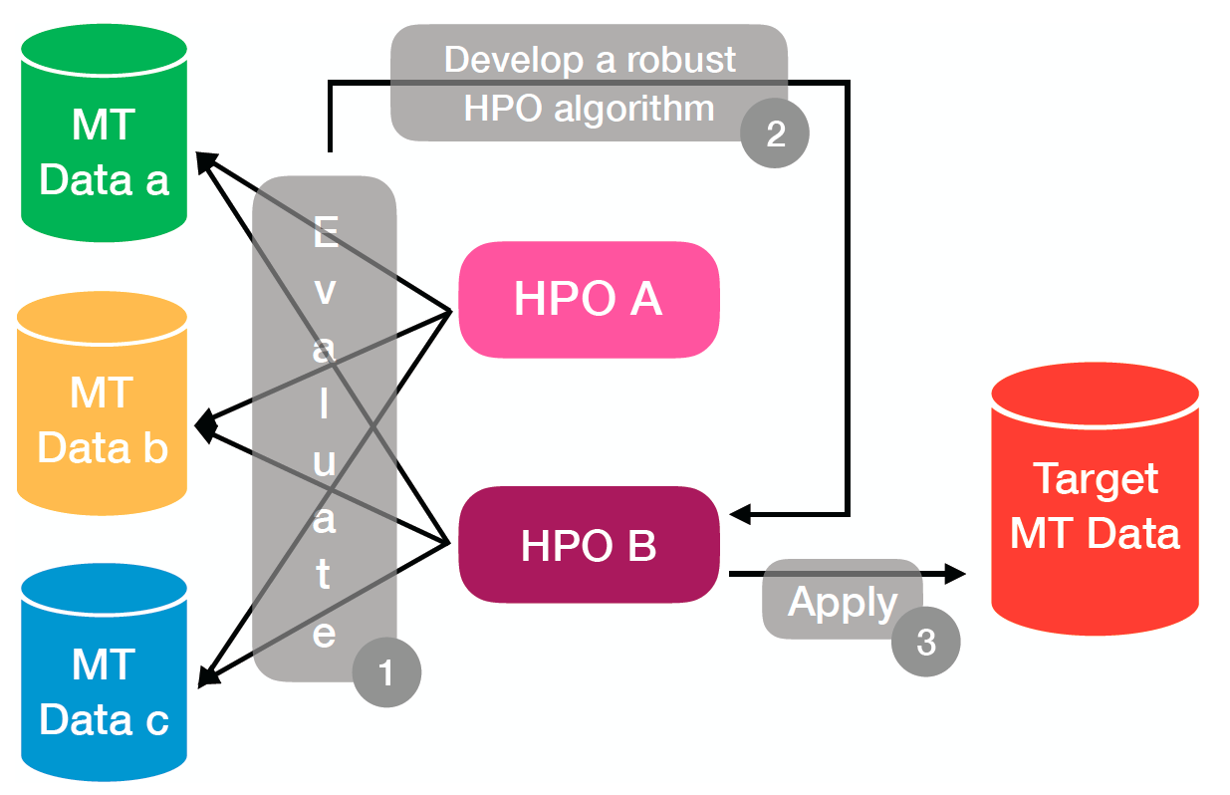

Slide 32
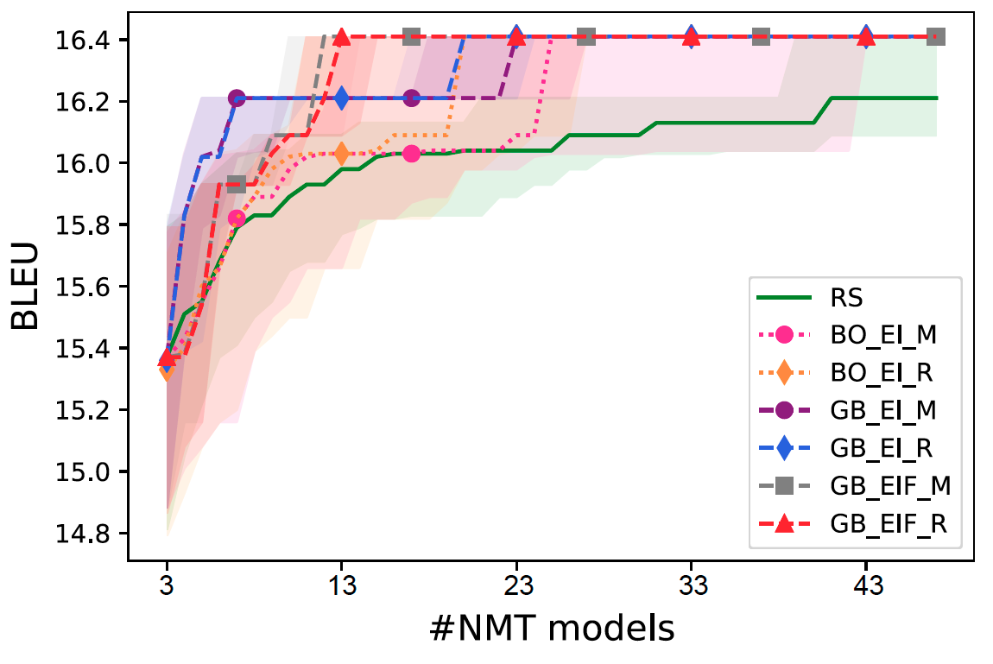
Interesting observations: (1) winner varies by budget. (2) high variance
RS: Random Search
BO: Bayesian Optimization
GB: Graph-based
ja-en dataset
Tabular Benchmark enables detailed run-time comparison

Slide 33
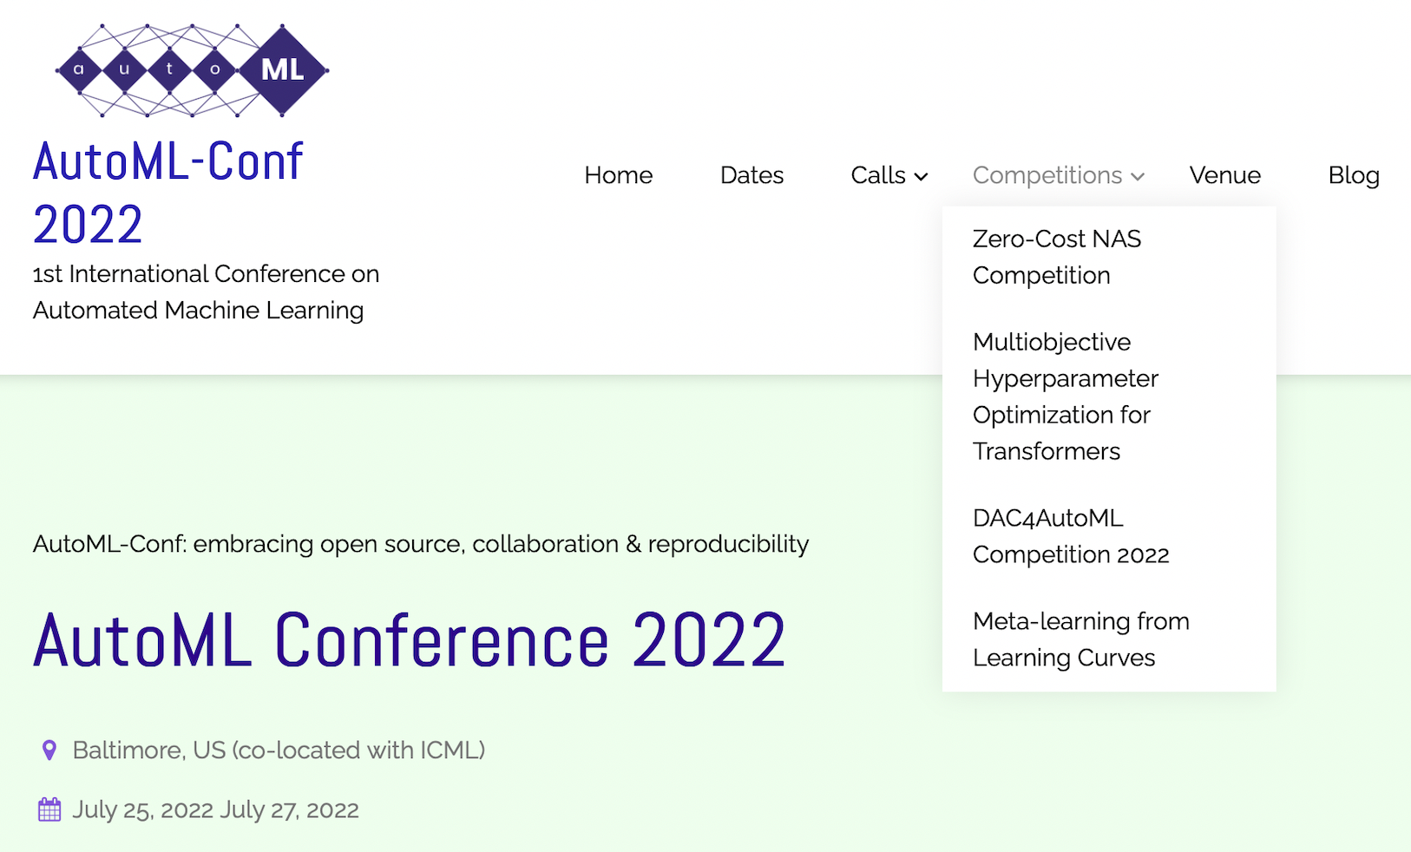
AutoML 2022 Competition https://automl.cc
Data available: https://github.com/Este1le/hpo_nmt

Slide 34
Outline
Motivation
Problem Definition & Representative Hyperparameter Optimization (HPO) Methods
HPO Benchmark for Machine Translation
Beyond black-box HPO

Slide 35
While low-resource settings are more amenable to HPO, cost can still be large
Suppose a model/pipeline takes 0.5 day to train (low-resource)
Suppose we optimize 5 hyperparameters, each with 3 possible values
3⁵ x 0.5 = 121 GPU days!

Slide 36
Black-box is bottleneck
Assume this is black box
Run to completion
f(.)
Hyperparameter setting
encoded as vector in R^{d}
Train Model on dataset, then run diagnostics
x
y=f(x)
3 → # layers
200 → # units/layer
1 → optimizer type
0.2 → learning rate
Accuracy (e.g. BLEU)
Find x* = argmax_{x} f(x) with few function evaluations

Slide 37
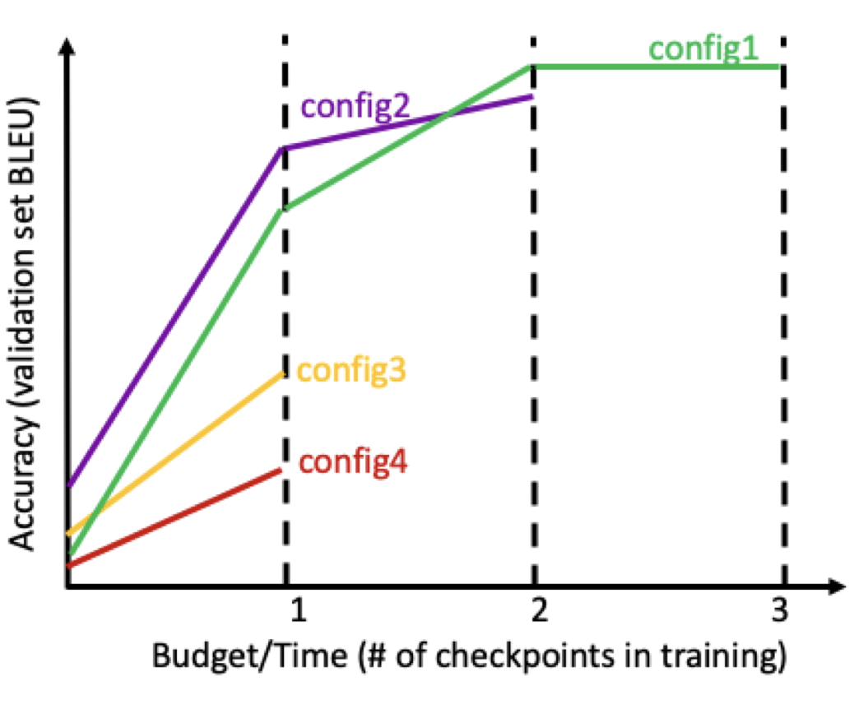
Opening the black-box
Successive Halving Algorithm
train n models in parallel
at each checkpoint, terminate the least promising half
continue training the rest
See: Jamieson and Talwalkar. Non-stochastic best arm identification and hyperparameter optimization. AISTATS 2016

Slide 38
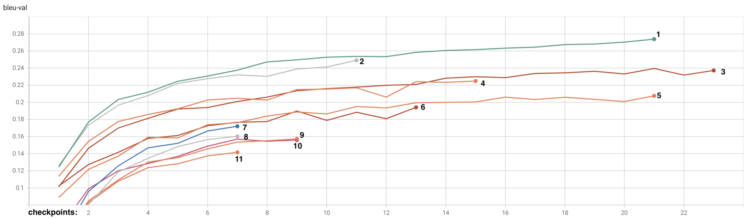
Successive Halving Algorithm (in detail)
Suppose n=11 configurations & 4 machines for parallel training
Decide schedule for halving: 7 checkpoints, 9 checkpoints, 11 checkpoints, etc.
First dispatch 4 jobs, train up to 7 checkpoints
Once done, continue dispatching until all 11 configurations trained to 7 checkpoints
Continue successive halving
“Best” model is trained to convergence
Terminate the worst performing models (by validation BLEU)
Continue training the remaining

Slide 39
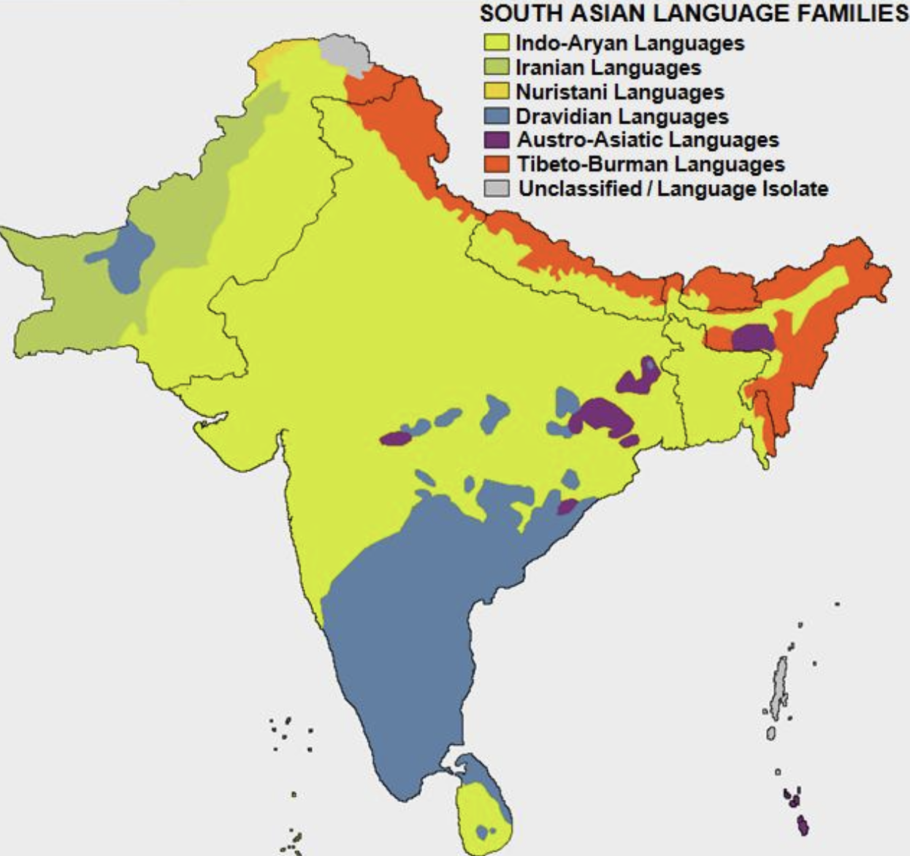
Example Low-Resource task:
Telegu-English MT with backtranslated data
900k lines of bitext from public sources on OPUS portal
7 million lines of backtranslated bitext from Leipzig corpus
Explore 1296 hyperparameter configurations, up to 25 checkpoints
  Grid search costs 25x1296 = 32,400 checkpoints
  Backtranslate data makes training more expensive
source: https://commons.wikimedia.org/wiki/File:South_Asian_Language_Families.jpg

Slide 40
Successive Halving results
Checkpoint | #configs running | Budget (total #checkpoint) | median BLEU if all trained to complete | max BLEU if all models trained to complete
5 | 1296 | 6480 | 0.3 | 20.3
7 | 648 | 7776 | 17.2 | 20.3
9 | 324 | 8424 | 18.9 | 20.3
11 | 162 | 8748 | 19.4 | 20.3
13 | 81 | 8910 | 19.7 | 20.3
15 | 40 | 8990 | 19.7 | 20.1
17 | 20 | 9030 | 19.7 | 20.1
19 | 10 | 9050 | 18.8 | 20.1
21 | 5 | 9060 | 19.8 | 20.1
23 | 2 | 9064 | 20.0 | 20.1
25 | 1 | 9066 | 20.1 | 20.1
60% less than grid search

Slide 41
Our NMT Tabular Benchmark (version 2)
Included learning curve (perplexity & BLEU) to encourage glass-box HPO research
Added MT Fine-Tuning for Large Language Models
Hyperparameter Type | Possible Values
LLM | BLOOMZ 560m, 1b, 3b XGLM 546m, 1.7b, 2.9b
LoRA rank | 2, 16, 64
Batch size | 16, 32, 64
Learning rate | 2e-5, 1e-4, 2e-4
Dataset | Domain | #models
de-en | WMT | 162
ru-en | WMT | 162
zh-en | WMT | 162

Slide 42
Summary
Hyperparameter optimization (HPO) is important, especially for low-resource tasks
AutoML field provides many HPO tools for practitioners
Rigorous evaluation of HPO for MT is needed → tabular benchmark
Glass-box HPO like Successive Halving improves upon traditional black-box HPO → worth adopting

Slide 43
Take-home message
Recipe for building strong systems for low-resource tasks:
Try all the usual research advances
  data augmentation, e.g. backtranslation
  multilingual models, pretrained models
  language-specific innovations
But don’t forget to optimize hyperparameters too!
  Scaling up to 100 or 1000 configurations is worthwhile and feasible with current HPO tools

Slide 44

References:
Xuan Zhang and Kevin Duh, Approaching Sign Language Gloss Translation as a Low-Resource Machine Translation Task, Proceedings of the 1st International Workshop on Automatic Translation for Signed and Spoken Languages
Xuan Zhang and Kevin Duh, Reproducible and Efficient Benchmarks for Hyperparameter Optimization of Neural Machine Translation Systems, Transactions of the Association for Computational Linguistics (TACL), vol. 8, 2020
Xuan Zhang, Kevin Duh, Paul McNamee, A Hyperparameter Optimization Toolkit for Neural Machine Translation Research, Proc. of the 61st Annual Meeting of the Association for Computational Linguistics (Volume 3: System Demonstrations), ACL 2023
Xuan Zhang and Kevin Duh, Best Practices of Successive Halving on Neural Machine Translation and Large Language Models, Proceedings of the 16th Biennial Conference of the Association for Machine Translation in the Americas (AMTA 2024)

